Slide 1
ASE 2025 Annual Conference
Practical work in a ‘post-Covid’ era
David Montagu, Royal Society
Steve Jones, CLEAPSS
Alistair Moore, University of York
Caroline Neuberg, Leeds Trinity University
Ed Walsh, Ed Walsh Consulting
11 January 2025

Slide 2
Introductions
Steve Jones
Director, CLEAPSS (since 2011). Enabled him to further indulge his interest in practical work and to develop a strong commitment to proportionate and common-sense approaches to managing risks in practical subjects
Taught science in secondary schools for 18 years before moving into advisory work, initially with Hertfordshire and then as a regional adviser with the Secondary National Strategies
Alistair Moore
Research Fellow, University of York Science Education Group
Co-Director of the Best Evidence Science Teaching (BEST) project
Specialist in applied research and innovative development in school science curriculum and assessment
Caroline Neuberg
Science teacher for 15 years, after 10 years of hands-on research in volcanology/ fluid dynamics
Regional Rep for Ogden Trust (‘Wow, How, Now’ approach) and ASE 11–19 Committee
Scientix ambassador (European collaboration in STEM) since 2018
Teacher educator at Leeds Trinity University since 2022
Intensive Training And Practice (ITAP) on signature pedagogies: practical work in science
Ed Walsh
Science teacher for 20 years including 12 as team leader
Local authority school guidance and support
CPD designer and deliverer for AQA and NSLC
Series Editor and author for Collins at KS3 and KS4
Project Consultant for ASE ‘Good Practical Science: Making it Happen’

Slide 3
About the SET
A nationally representative survey of students in England aged 11–18 exploring their:
  engagement with science outside school
  experiences of science education, including practical science
  subject choices and pathways post-16
  STEM career aspirations
Originally established by Wellcome in 2016 and repeated in 2019
The 2023 survey was grant-funded by Wellcome with additional funding from the Royal Society
  Delivery partner: EngineeringUK
  Survey work, analysis and reporting: Verian (formerly Kantar Public)
Sample size: 7,256 (approx. 1,000 per year group)
Report published in April 2024: royalsociety.org

Slide 4

Interest in science has declined
76
77
76
75
75
71
71
65
59
55
53
52
Boys
Girls
Biology
Chemistry
Physics
All years 7–9
Years 7–9
Years 10–13

Slide 5
Why interest has declined
It can be difficult
A lot to learn/
remember
Not enough practical work or experiments
The most important factor encouraging all year 7–9 students to study science
Don’t find some topics interesting
and
Doesn’t fit with study/career plans
The teacher/
one of my teachers

Slide 6
Practical work in science: access
Pre-pandemic fall

Slide 7
Practical work in science: access
Pre-pandemic fall

Slide 8
Practical work in science: access

Slide 9
Practical work in science: quality

Slide 10
Practical work in science: quality

Slide 11
Practical work in science: projects
Engagement in extracurricular STEM activities
% of year 7–13 students engaging in STEM-based extracurricular activities in the past school year
4
8
12
9
10
15
17
Extent to which engagement by year 7–13 students in STEM-based extracurricular activities in the past school year encouraged them to learn science, computer science, engineering and mathematics (%)
and
Encouraged
No difference
Put off
Don’t know

Slide 12
Conclusions
Opportunities to participate in hands-on practical work are a significant factor in motivating students to learn science.
Students’ desire to do more hands-on practical work contrasts with a sharp decline in provision over the past decade.
The range and quality of hands-on practical work offered varies.
Students on the Triple Science pathway have more opportunities to do hands-on practical work – and experience higher-quality practical work – than students doing Combined Science.
There should be more opportunities for students to undertake open-ended independent research investigations.

Slide 13
Steve:
Covid and everything after
As the smell of Milton final fades into a distant memory, what is the current state of practical work in science?
A perfect storm?
Teacher shortages in some subject areas
Fewer technicians
Less experienced teachers and technicians
Restricted budgets for resources

Slide 14

Evidence
Calls and e-mails to the CLEAPSS Helpline
  Approx. 8,000 enquiries per year
  Roughly half of these relate to chemistry
Conversations with teachers and technicians on CLEAPSS training
  Approx. 200 courses with 3700 participants in total
Pattern of adverts on the CLEAPSS technician job service
  400+ adverts in a 12 month period
Anecdotal in nature
Can lead to a jaundiced world view!

Slide 15
Since the pandemic
More Helplines – 30% increase
Many of the enquiries are about much simpler things
“I know you say the radioactives storage cabinet has to be 2m away from any permanent workstation, but is 3m OK?”
“How do you make a 1% solution?” (believing that this would be a 1M solution)
Trying to neutralise conc. HCl with 50ml of 0.1M sodium carbonate (more than 2L would be needed – the term ‘STRONG ACID’ does not mean concentrated)
“Could you explain what Sodium thiosulfate solution (40 g dm–3 ) means?”
“How do you incubate cultures on agar plates?”
How long is a piece of string? (the wick in a spirit burner)

Slide 16
Then of course there are the Health and safety questions…
Many enquirers are increasingly looking for someone else to make the decision for them.
“Morning, I have been asked a few questions from a member of the trust. It is information that is needed regarding another school. I already know the answers, but they would like confirmation from yourselves in writing via email please!
Is eating/drinking in labs a no for students and staff?
If the benches are cleaned, would they be able to eat/drink in the lab?
If a cake was brought in, would it be OK to keep it in the prep room where chemicals are kept?”
“The workshop in the basement is starting to flood due to the rain. Given the presence of machinery like the circular saw, bandsaw, and others, I am concerned about the safety of continuing to work in these conditions….”

Slide 17
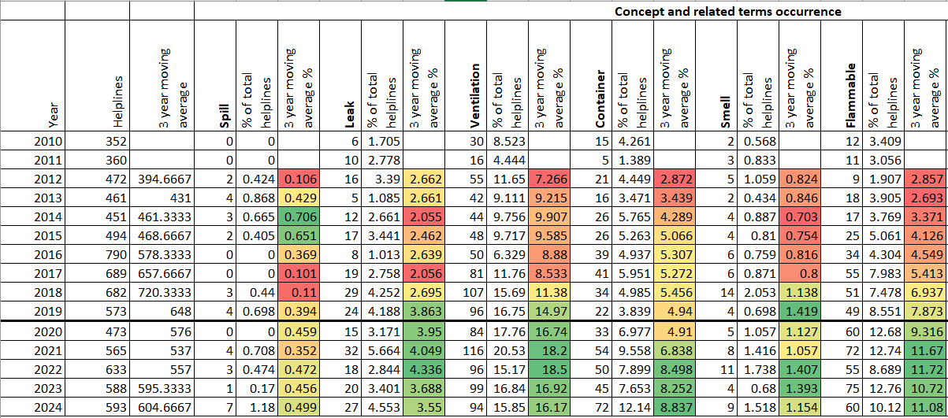
Trends over time - Helplines related to ‘Chemical Stores’

Slide 18



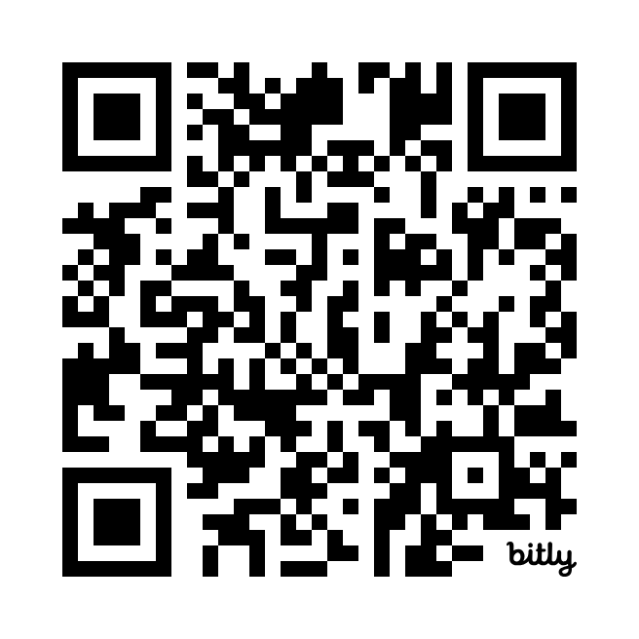



Alistair: research evidence suggests ways we can ensure practical work supports learning
Research study on pedagogy and assessment in school science practical work (‘PASS’)
Practical experiences that better supported learning included a series of teacher-led interactions which involved:
teacher-student dialogue
focussed questioning.
Through these:
the teacher guided students through key aspects of the practical activity
  this focused students’ attention on important points related to the learning outcomes, including procedural understanding and key process skills
the teacher prompted students to be active participants
  this encouraged students to think and talk about what was being done and why, and to relate it to other practical work and ideas.
Project overview:
Four-year research study
Qualitative and quantitative data collected from students (n=1911) and their teachers in schools across Yorkshire and London
Provided empirical evidence that:
Practical videos were the least effective way to develop disciplinary knowledge and understanding
Hands-on practical work and teacher demos were the most effective ways
Some teaching practices improved learning regardless of the ‘format’ of the practical activity
Practical work should be:
bit.ly/3OysfFc
Guided
Active
Research funded by:
Purposeful

Slide 19
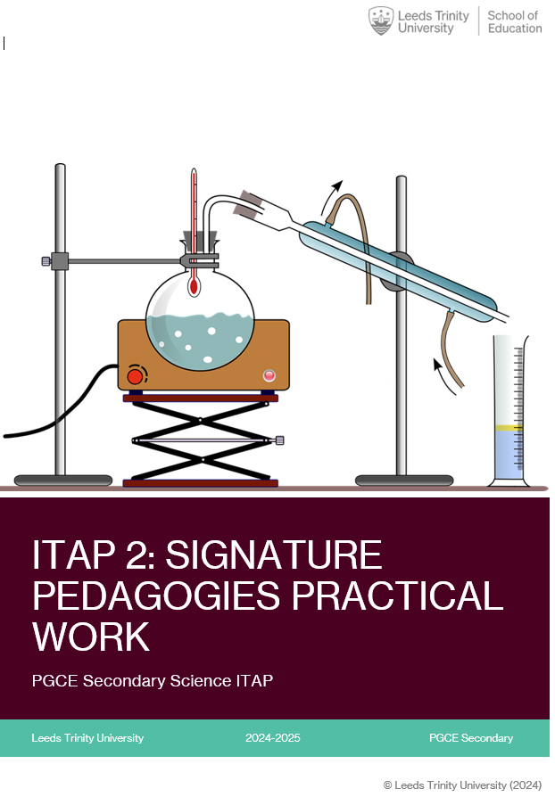
Caroline:
Current trainees had their own university learning disrupted
Trainees are concerned with behaviour management: harder to control a moving crowd
Trainees have expressed a concern for responsibility in Health and safety
International trainees have expressed their lack of knowledge in practical work
Prepared to accept demo as practical
Extreme case: prepared to accept online simulation as practical

Slide 20
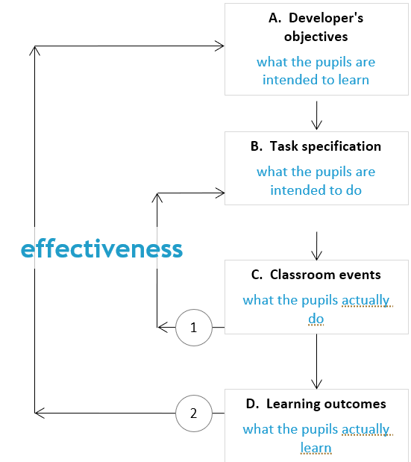
Ed: findings from Good Practical Science report (Gatsby, 2017) and ‘Analysing Practical Science Activities’ (Millar, 2010)
We need to be absolutely clear what the purpose of practical work is (developing manipulative skills, improving enquiry skills, understanding science concepts better, developing ‘soft skills’ and being motivated).
The outcomes should be modest in number and tailored to students’ learning needs.
We need to design and deliver experiments against those outcomes and then identify and celebrate the progress made so that both teachers and students see practical work as being a powerful learning tool.

Slide 21
Caroline:
Learning is emotional :
There is no ‘quick fix’, or ‘magic bullet’
Head, Heart and Hands: Royal Academy of Engineering
There is no list of ‘effective practicals’
Any practical activity can be used ineffectively
Some that might be thought ‘dull’ can be used effectively by a good teacher
The key to improvement lies in encouraging more reflective practice
Hanson, J. and Lucas B. (2022). Head, Heart and Hands: Powerful examples of practical learning in schools. London: Royal Academy of Engineering

Slide 22
Responding to the challenge
Developing training, support and guidance that makes the inaccessible, accessible is always what CLEAPSS has done
In the last 12 months we have written guidance on:
  Alkali metals and water
  Burning magnesium ribbon
  How to use a fume cupboard
How low can we go?
In truth we are not sure.
Access to subject specific training?
Don’t buy it, make it.
Opportunities for microscale approaches.

Slide 23
Something upbeat to take away!
If you are:
an early career teacher;
the only teacher in your department with a science background;
And:
your department only has one technician who is long-term sick;
the chemical store is cordoned off because the ceiling is made of RAAC;
you have three flat batteries and a broken bulb holder…
Then, despite all the challenges, the evidence shows that:
Hands on practical work is one of the most effective ways for pupils to learn science.
You have always suspected this was the case, but now you know!
So don’t give up on it!

