Slide 1
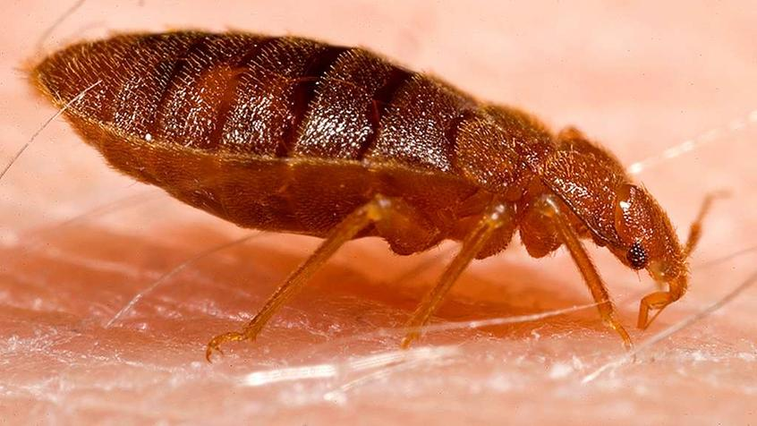
The science of evolution by natural selection
© 2025. Association for Science Education & Big Ideas for RE
Notes:
Creative commons https://picryl.com/media/adult-bed-bug-cimex-lectularius-ee47a5

Slide 2
These individuals all belong to the same species – dogs.
How are the dogs different?
© 2025. ASE & Big Ideas for RE
Notes:
Creative Commons https://cosmodoggyland.com/breeds-101/#prettyPhoto

Slide 3
Differences in characteristics are called variation.
Another type of variation is environmental variation. This depends on things like what an individual eats, or how much light or water it gets.
Genes cause variation between individuals. This is inherited variation.
© 2025. ASE & Big Ideas for RE
Notes:
Left image Creative Commons https://cosmodoggyland.com/breeds-101/#prettyPhoto
Plants - Shutterstock

Slide 4
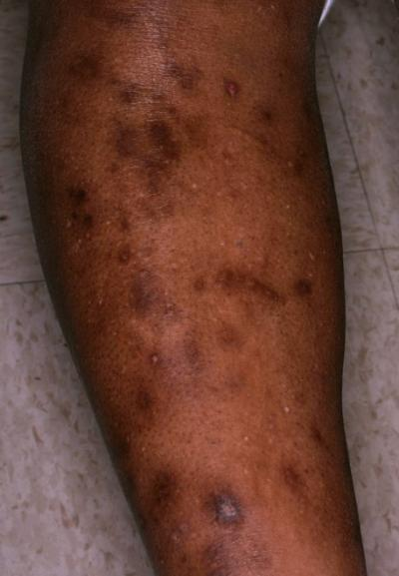
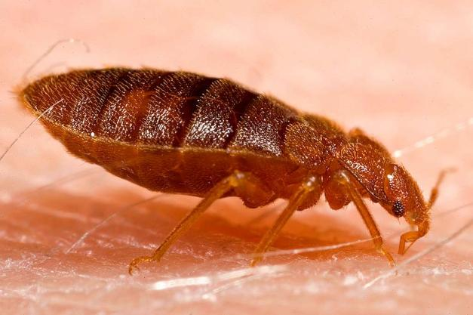
Bed bugs bite
© 2025. ASE & Big Ideas for RE
Notes:
Top image – James Heilman MD, Creative Commons https://commons.wikimedia.org/wiki/File:Bedbugb2.JPG
Left image – Creative commons https://picryl.com/media/adult-bed-bug-cimex-lectularius-ee47a5
Right image – Visual DX

Slide 5
In the 1950s, people used insecticide sprays to control bed bugs.
By the 1960s, new generations of bed bugs had thicker shells. The 1950s sprays did not kill these bed bugs.
https://picryl.com/media/adult-bed-bug-cimex-lectularius-ee47a5
© 2025. ASE & Big Ideas for RE
Notes:
Creative commons https://picryl.com/media/adult-bed-bug-cimex-lectularius-ee47a5

Slide 6
Which explanation explains why bed bug shells became thicker?
Variation in genes meant some bed bugs had thicker shells.
When sprayed, more thick shelled bugs survived.
The surviving bugs reproduced. Thicker shelled bugs have thicker shelled young.
The process repeated over many generations. Over time, thicker shelled bugs became more common.
When a bed bug was sprayed with insecticide, its shell grew thicker.
The more it was sprayed, the thicker its shell became.
© 2025. ASE & Big Ideas for RE
Notes:
Creative commons https://picryl.com/media/adult-bed-bug-cimex-lectularius-ee47a5

Slide 7
Evolution explains why bed bug shells became thicker.
Variation in genes meant some bed bugs had thicker shells.
When sprayed, more thick shelled bugs survived.
The surviving bugs reproduced. Thicker shelled bugs have thicker shelled young.
The process repeated over many generations. Over time, thicker shelled bugs became more common.
© 2025. ASE & Big Ideas for RE
Notes:
Creative commons https://picryl.com/media/adult-bed-bug-cimex-lectularius-ee47a5

Slide 8
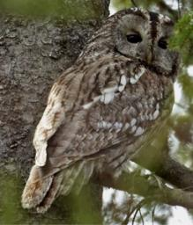
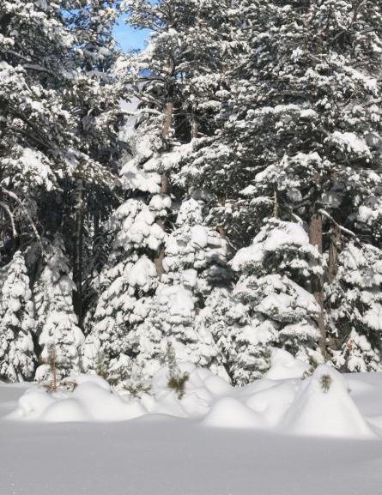
Natural selection explains evolution.
Step 1 Variation
Genes cause variation between individuals.
Step 2 Survival of the fittest
In the past, there was more snow. The greyer owls were better camouflaged. More grey owls survived.
Step 3 Reproduction and inheritance
The surviving owls reproduced. Grey owls have grey chicks.
The advantageous characteristic – grey colour – led to more grey chicks. Over many generations, greyer owls became more common.
Tawny owls in Finland – some are more grey and some are more brown.
© 2025. ASE & Big Ideas for RE
Notes:
Owls images – Dick Forsmas in Nature Comms https://www.nature.com/articles/ncomms1213
Snowy trees – Christmas stocking images, Creative Commons https://commons.wikimedia.org/wiki/File:Snow_on_fir_trees.jpg

Slide 9
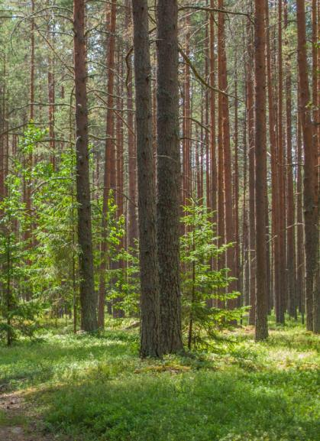
Now there is less snow in Finland. Browner tawny owls are better camoflagued.
How do you think the colour of owls in the population is changing? Why?
Tawny owls in Finland – some are more grey and some are more brown.
Use these steps to explain your idea:
Step 1 Variation
Step 2 Survival of the fittest
Step 3 Reproduction and inheritance
© 2025. ASE & Big Ideas for RE
Notes:
Owls images – Dick Forsmas in Nature Comms https://www.nature.com/articles/ncomms1213

Slide 10
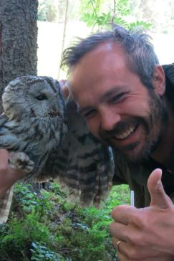
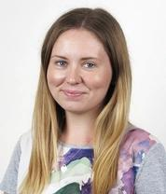
Sharissa Latham, University of Sydney, Australia, collaborated on the bed bug research.
She now researches new breast cancer treatments.
Shyman Gopalakrishnan works at the University of Copenhagen, Denmark.
His work includes research on dog evolution, including on dogs that pull sleds in the Arctic.
Patrik Karell, University of Uppsala, Finland, led the owl research.
His research focuses on how plants and animals adapt to climate change.
© 2025. ASE & Big Ideas for RE
Notes:
Image from: https://www.uu.se/en/contact-and-organisation/staff?query=N23-536
Image from: https://www.garvan.org.au/people/researchers/sharissa-latham
https://www.linkedin.com/in/shyam-gopalakrishnan-ba860b21/?originalSubdomain=dk

Slide 11
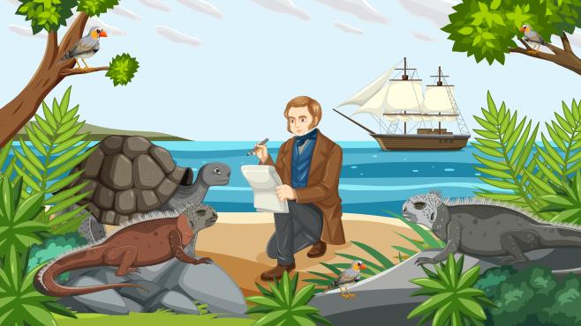
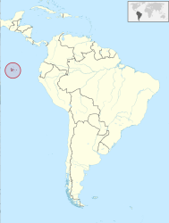
Evidence for natural selection: observation
In 1835, Charles Darwin observed animals, plants and rocks in the Galapagos Islands.
© 2025. ASE & Big Ideas for RE
Notes:
Left image – Shutterstock https://www.shutterstock.com/image-vector/charles-darwin-expedition-galapagos-concept-illustration-2275584461
Right image – Creative Commons https://commons.wikimedia.org/wiki/File:Galapagos_Islands_in_South_America.svg

Slide 12
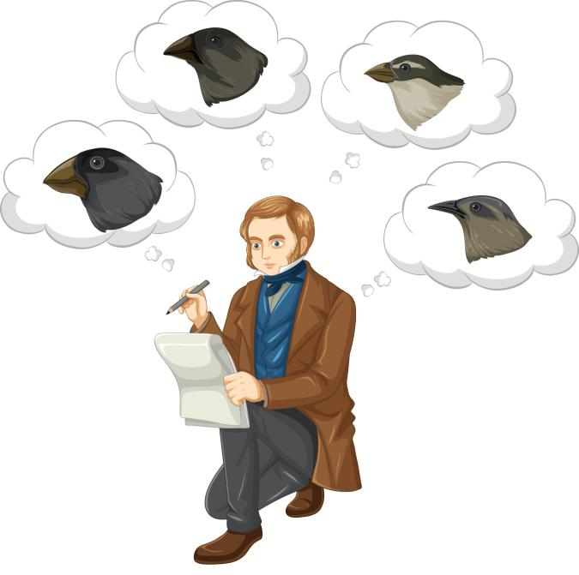
Evidence for natural selection: observation
Darwin noticed different – but closely related – bird species on different islands.
The birds were similar to a species in mainland South America. Their body shapes, feathers and songs were alike. But their beak shapes were different.
© 2025. ASE & Big Ideas for RE
Notes:
Shutterstock https://www.shutterstock.com/image-vector/charles-darwin-thinking-about-finches-birds-2313887727

Slide 13
Evidence for natural selection: observation
Back home, Darwin discussed his observations with a bird expert. He thought carefully over several years.
In 1845, Darwin wrote:
“Seeing this diversity of [beak] structure in one small, intimately related group of birds, one might really fancy that … one species had been taken and modified for different ends.”
© 2025. ASE & Big Ideas for RE
Notes:
Shutterstock https://www.shutterstock.com/image-illustration/natural-selection-adaptation-darwins-theories-adaptive-1959125539

Slide 14
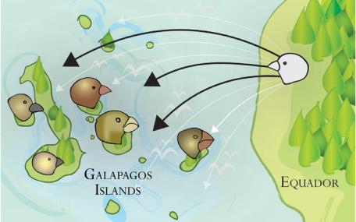
Evidence for natural selection: observation
Darwin suggested that individuals of one original species of bird travelled from the mainland to different islands.
Different islands had different food sources. So on each island, the birds evolved different beaks.
© 2025. ASE & Big Ideas for RE
Notes:
Image from https://www.coolgalapagos.com/animals/galapagos-darwins-finches.php

Slide 15
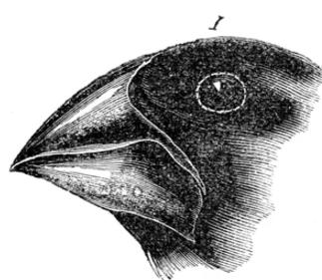
Evidence for natural selection: observation
Step 1 Variation
In the mainland bird species, there were variations in beak size and shape.
Step 2 Survival of the fittest
One island had a good food source – seeds. But the seeds had hard shells. More birds with bigger, stronger beaks survived.
Step 3 Reproduction and inheritance
The surviving birds reproduced. Their chicks had bigger, stronger beaks. The process repeated over many generations. On this island, birds with big, strong beaks became common. A new species had evolved.
© 2025. ASE & Big Ideas for RE
Notes:
Image by Charles Darwin https://commons.wikimedia.org/wiki/File:Charles_Darwin,_Journal_of_Researches..._Wellcome_L0026712.jpg

Slide 16
Evidence for natural selection: observation
Choose one bird species from the pictures.
Suggest which food it eats. How is it adapted to this food source?
Describe the steps that explain how this species evolved from the original species.
© 2025. ASE & Big Ideas for RE
Notes:
Shutterstock https://www.shutterstock.com/image-illustration/natural-selection-adaptation-darwins-theories-adaptive-1959125539

Slide 17
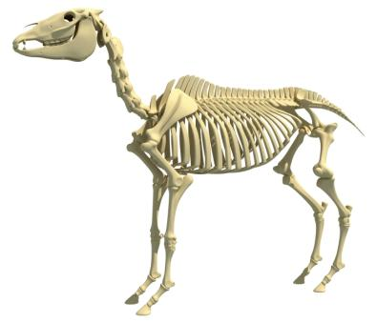
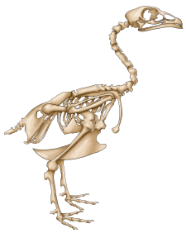
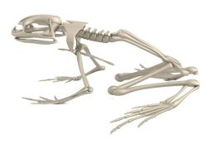
Evidence for natural selection: observation
What animals do you think the skeletons are from?
Look at the four skeletons.
How are they similar?
How are they different?
How do you think the skeletons provide evidence of a common ancestor for all vertebrates?
Not to scale
© 2025. ASE & Big Ideas for RE
Notes:
Images from Shutterstock
https://www.shutterstock.com/image-illustration/killer-whale-orca-skeleton-3d-rendering-2176189427
https://www.shutterstock.com/image-illustration/realistic-3d-render-frog-skeleton-189109493
https://www.shutterstock.com/image-illustration/horse-skeleton-anatomy-3d-rendering-on-2178673357
https://www.shutterstock.com/image-illustration/chicken-skeleton-642959911

Slide 18
Evidence for natural selection: observation
orca (killer whale)
horse
frog
chicken
Not to scale
© 2025. ASE & Big Ideas for RE
Notes:
Images from Shutterstock
https://www.shutterstock.com/image-illustration/killer-whale-orca-skeleton-3d-rendering-2176189427
https://www.shutterstock.com/image-illustration/realistic-3d-render-frog-skeleton-189109493
https://www.shutterstock.com/image-illustration/horse-skeleton-anatomy-3d-rendering-on-2178673357
https://www.shutterstock.com/image-illustration/chicken-skeleton-642959911

Slide 19
Evidence for natural selection: artificial selection
For many years, people have selected individual dogs with desirable characteristics, and bred from them.
This is artificial selection.
Choose a dog breed. Which characteristics did people look for, when choosing which individual dogs to breed from?
Is artificial selection evidence for natural selection? Why, or why not?
© 2025. ASE & Big Ideas for RE
Notes:
Creative Commons https://cosmodoggyland.com/breeds-101/#prettyPhoto

Slide 20
Evidence for natural selection: artificial selection
Choose one vegetable on the next slide.
Which characteristics did people look for, when choosing which individual wild mustard plants to breed from?
Choose from:
Leaves
Stem
Flower buds
Flower buds and their stems
Leaf buds at the end of a stalk
Leaf buds along a stalk
Over many years, people have bred six different vegetables from the wild mustard plant.
© 2025. ASE & Big Ideas for RE
Notes:
Image https://www.instagram.com/victoriafarmersmarket/p/C1BF68isOZQ/?img_index=1
Q on ethics of artificial selection – to feed growing world population
Needs more of an activity

Slide 21
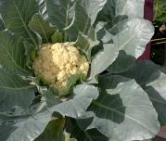
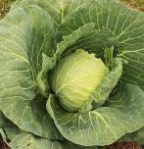
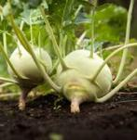
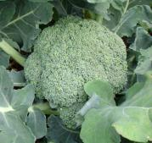
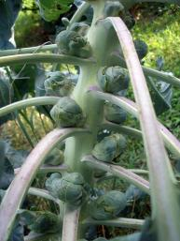
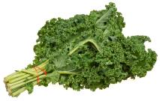
Evidence for natural selection: artificial selection
flower buds and their stems
flower bud
leaf buds at the end of a stalk
cauliflower
cabbage
kohlrabi
leaf buds along a stalk
stem
broccoli
leaf
wild mustard plant
sprouts
kale
© 2025. ASE & Big Ideas for RE
Notes:
Image of wild mustard plant https://www.instagram.com/victoriafarmersmarket/p/C1BF68isOZQ/?img_index=1
Broccoli https://commons.wikimedia.org/wiki/File:Broccoli2.jpg
Cauliflower https://commons.wikimedia.org/wiki/File:Cauliflower_in_home_garden.jpg
Cabbage – Alabama Extension https://commons.wikimedia.org/wiki/File:Cabbage_close_up_%2849200263532%29.jpg
Kohlrabi – public domain https://www.rawpixel.com/image/6037170/photo-image-public-domain-plant-green
Sprouts – Tony Alter https://commons.wikimedia.org/wiki/File:Brussels_Sprouts_%283743349961%29.jpg
Kale – Evan-Amos https://commons.wikimedia.org/wiki/File:Kale-Bundle.jpg

Slide 22
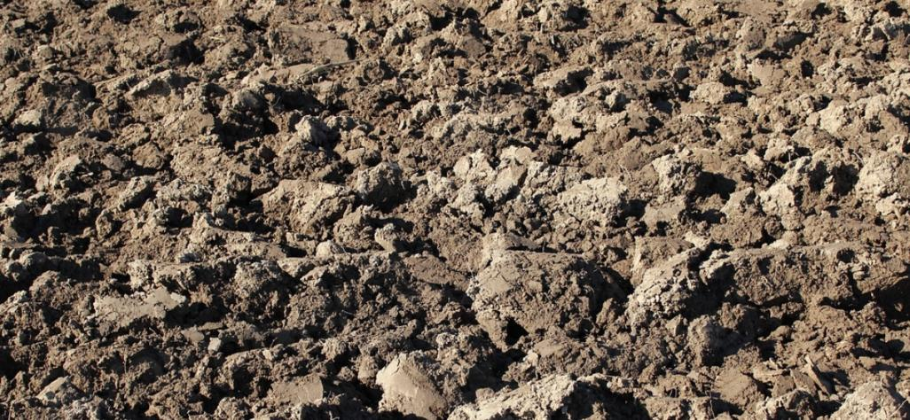
Evidence for natural selection: artificial selection
© 2025. ASE & Big Ideas for RE
Notes:
Soil background Creative Commons https://www.rawpixel.com/image/6041417/closeup-soil-free-public-domain-cc0-photo
Wild mustard plant https://www.instagram.com/victoriafarmersmarket/p/C1BF68isOZQ/?img_index=1

Slide 23
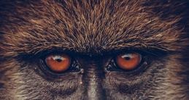
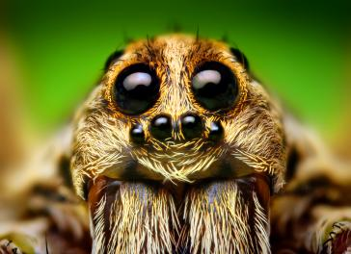
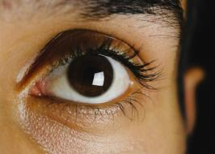
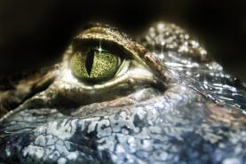
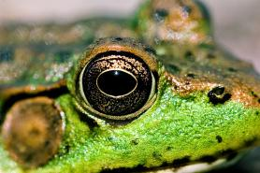
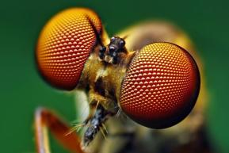
Evidence for evolution: eyes
© 2025. ASE & Big Ideas for RE
Notes:
Top left – nautilus by Manuae, Creative Commons https://commons.wikimedia.org/wiki/File:Nautilus_belauensis_from_Palau.jpg
Top middle – wolf spider by Thomas Shahan, Creative Commons https://en.wikipedia.org/wiki/Spider_vision#/media/File:Eye_Arrangement_of_a_Hogna_Wolf_Spider.png
Top right – macaque, Creative Commons https://pxhere.com/en/photo/1600576
Bottom left – crocodile, Creative Commons https://www.pexels.com/photo/close-up-photo-of-crocodile-eye-1203583/
Bottom middle – frog by Ren West, Creative Commons https://commons.wikimedia.org/wiki/File:Frog_eye_closeup.jpg
Bottom right – fly by Thomas Shahan, Creative commons https://www.upr.org/science/2018-08-30/new-discovery-about-fly-eyes-could-help-scientists-better-understand-human-night-blindness
Middle right – human eye by Aaqrabate, Creative Commons https://www.pexels.com/photo/closeup-photo-of-left-human-eye-1210016/

Slide 24
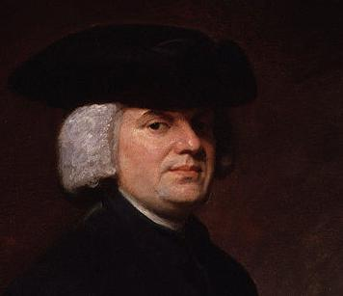
Evidence for evolution: eyes
Animals are complex. There must be an intelligent mind to design them.
William Paley (1743-1805)
© 2025. ASE & Big Ideas for RE
Notes:
Painting by George Romney and displayed in National Portrait Gallery, London. https://commons.wikimedia.org/wiki/File:William_Paley_by_George_Romney.jpg

Slide 25
Evidence for evolution: eyes
The evolution of the eye by natural selection seems absurd at first glance…
But there are many sorts of eyes. Complex eyes could have evolved from simple ones by natural selection, if each change was useful.
The key is to find intermediate eyes to show a path from simple to complex.
Charles Darwin Origin of Species, 1859 (paraphrased)
© 2025. ASE & Big Ideas for RE
Notes:
Image – Shutterstock https://www.shutterstock.com/image-vector/charles-darwin-thinking-about-finches-birds-2313887727

Slide 26
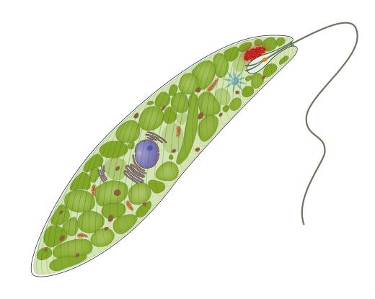
Evidence for natural selection: eyes
Step 1 Evolve light-sensitive cells
A single-celled Euglena has an eyespot made of light-sensitive pigments.
It can swim towards light.
length is less than 1 mm
How might the eyespot benefit Euglena?
© 2025. ASE & Big Ideas for RE
Notes:
Shutterstock https://www.shutterstock.com/image-illustration/schematic-illustration-euglena-gracilis-2100559543

Slide 27
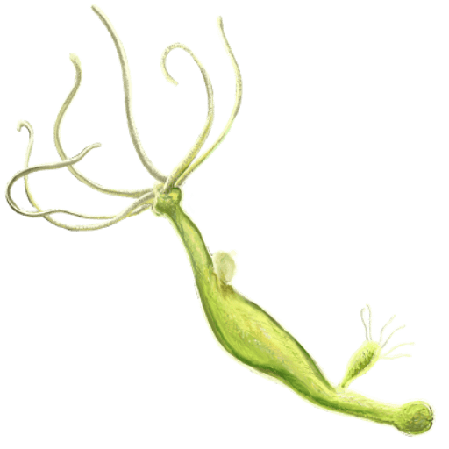
Evidence for natural selection: eyes
Step 2 In multicellular organisms, put several light-sensitive cells in one place.
The organism can detect light and where it comes from.
Hydra have light-sensitive patches on the body wall and tentacles.
How might the light-sensitive cells benefit Hydra?
length up to 1 cm
© 2025. ASE & Big Ideas for RE
Notes:
Image DataBase Center for Life Science (DBCLS) https://commons.wikimedia.org/wiki/File:202107_Hydra.svg

Slide 28
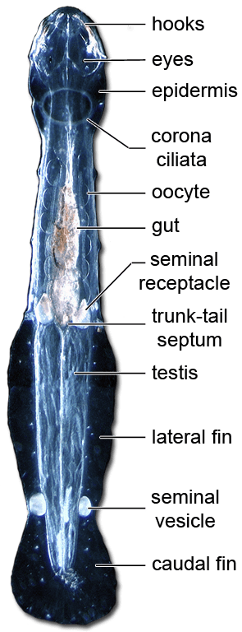
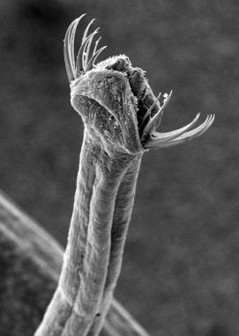
Evidence for natural selection: eyes
Step 3 Evolve a tiny depression (pigment cup) for the light-sensitive cells.
The animal can detect where light comes from. It can sense movement.
How might a pigment cup benefit an arrowworm?
Arrowworms are a type of plankton. They are 1-10 cm long.
© 2025. ASE & Big Ideas for RE
Notes:
https://www.visualcapitalist.com/eye-evolution/#google_vignette
https://pmc.ncbi.nlm.nih.gov/articles/PMC3143066/
Left image – by Zatelmar, Creative Commons https://commons.wikimedia.org/wiki/File:MEB_back.png
Right image – by Zatelmar, Creative Commons https://en.wikipedia.org/wiki/Chaetognatha#/media/File:Chaetomorpho.png

Slide 29
Evidence for natural selection: eyes
Step 3 Evolve a narrow opening to the pit, like a pinhole camera.
The animal can see simple, blurred images.
eye
How might this benefit Nautilus?
Nautilus belauensis
© 2025. ASE & Big Ideas for RE
Notes:
Image by Manuae https://commons.wikimedia.org/wiki/File:Nautilus_belauensis_from_Palau.jpg

Slide 30
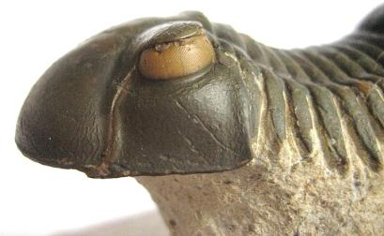
Evidence for natural selection: eyes
Step 5 Evolve a lens to focus light.
Animals with eye lenses can see clearly, judge distances and catch food.
Fossilised trilobite eye – about 400 million years old
Trilobites were excellent predators – they used their complex eyes to spot and catch prey.
How might the eye lens benefit trilobites?
© 2025. ASE & Big Ideas for RE
Notes:
Image from https://commons.wikimedia.org/wiki/File:Trilobites_Holochroal_Eye.JPG

Slide 31
Evidence for natural selection: eyes
Biologists have evidence that eyes evolved independently many, many times.
© 2025. ASE & Big Ideas for RE
Notes:
Top left - Thomas Shahan Creative commons https://www.upr.org/science/2018-08-30/new-discovery-about-fly-eyes-could-help-scientists-better-understand-human-night-blindness
Top right – human eye Aaqrabate, Creative Commons https://www.pexels.com/photo/closeup-photo-of-left-human-eye-1210016/
Bottom left – crocodile, Creative Commons https://www.pexels.com/photo/close-up-photo-of-crocodile-eye-1203583/
Bottom middle – frog by Ren West, Creative Commons https://commons.wikimedia.org/wiki/File:Frog_eye_closeup.jpg
Bottom right – wolf spider by Thomas Shahan, Creative Commons https://en.wikipedia.org/wiki/Spider_vision#/media/File:Eye_Arrangement_of_a_Hogna_Wolf_Spider.png

Slide 32
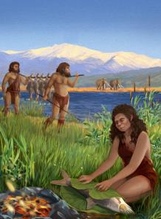
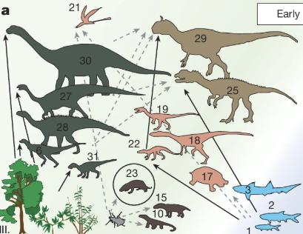
Evidence for natural selection: more evidence next time
© 2025. ASE & Big Ideas for RE
Notes:
Fish – Smithsonian Environmental Research Center, Creative Commons https://commons.wikimedia.org/wiki/File:Menidia_menidia_RR_08-11-19_0545_(48555459552).jpg
Cooking fish – illustration by Ella Maru, Tel Aviv University https://phys.org/news/2022-11-oldest-evidence-cook-food.html
Food web – Nature Fig. 1: Terrestrial vertebrate assemblages from the Polish Basin across the Carnian to Hettangian. | Nature in Qvarnström, M., Vikberg Wernström, J., Wawrzyniak, Z. et al. Digestive contents and food webs record the advent of dinosaur supremacy. Nature 636, 397–403 (2024). https://doi.org/10.1038/s41586-024-08265-4

