Slide 1
Evolution and/or creation: The Scopes Monkey Trial 100 years on
Denise Cush
Marianne Cutler
Dave Francis
Philippa Hulme
Michael Reiss
© 2025. Association for Science Education & Big Ideas for RE

Slide 2
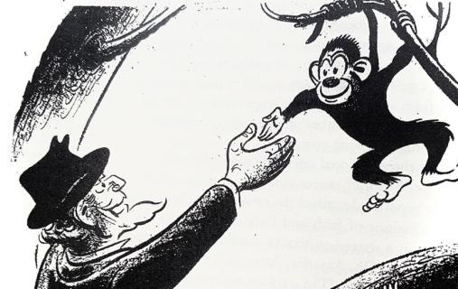
Evolution and/or creation: The Scopes Monkey Trial 100 years on
"I may be leaving... Guess I've been a monkey long
enough”
Charles Bissell / The Tennessean via Imagn Images
© 2025. Association for Science Education & Big Ideas for RE
Notes:
ILLUSTRATION (“AS IS”): https://www.newspapers.com/image/113336182 "I may be leaving... Guess I've been a monkey long enough” – Charles Bissell / The Tennessean – 4/15/1967 Charles Bissell / The Tennessean via Imagn Images

Slide 3
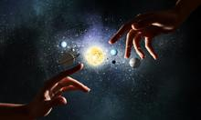
The Law in the State of Tennessee in 1925
“It shall be unlawful for any teacher… to teach any theory that denies the Story of the Divine Creation of man as
taught in the Bible, and to teach instead that man has descended from a lower order of animals.”
© 2025. ASE & Big Ideas for RE
Notes:
Photo: https://as2.ftcdn.net/jpg/01/09/85/93/220_F_109859341_ZGgrxdSkDpR3izHLB8SD3KKZ1YQExaJN.jpg Creative Commons

Slide 4
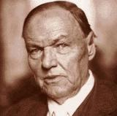
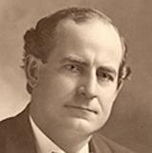
The ‘Monkey’ Trial explained
John Scopes arrested for teaching evolution, Dayton, Tennessee
Famous lawyers hired for prosecution and defence of Scopes [Clarence Darrow & William J Bryan]
Films: Inherit the Wind [1960; 1988; 1999]
Scopes was found guilty, fined $100 but later acquitted on appeal
Impact on what people thought of science and interpretation of the Bible - start of the ‘Culture wars’.
© 2025. ASE & Big Ideas for RE
Notes:
Left: Photo: https://turtledove.fandom.com/wiki/Clarence_Darrow / Community content is available under CC-BY-SA
Right: Photo: Creative Commons: https://hiki.pedia.ws/wiki/William_Jennings_Bryan

Slide 5
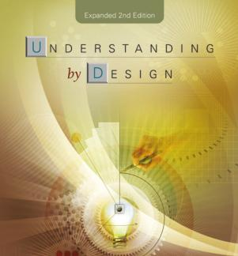
Big Ideas in Science and RE
Technical term originating with Jay McTighe & Grant Wiggins in the US, 2005
Adapted by Wynne Harlen for Science Curriculum, 2010
Barbara Wintersgill inspired to apply to RE, 2016
Prioritising of subject knowledge to focus on the central concerns of the subject, not isolated facts
Relevant, Memorable and Transferable
Structured progression.
© 2025. ASE & Big Ideas for RE
Notes:
Wiggins & McTighe: https://cft.vanderbilt.edu/guides-sub-pages/understanding-by-design/

Slide 6
Big Ideas for the topic
SCIENCE:
The diversity of organisms, living and extinct, is the result of evolution.
Scientific methods and theories develop as earlier explanations are modified to take account of new evidence and ideas
RE / RELIGION & WORLDVIEWS (RW) – BIG IDEA 6: THE BIG PICTURE
Religions / worldviews provide ‘grand narratives’ of how and why the world is as it is: the big questions about the universe and humanity.
Authoritative texts / traditions are interpreted in different ways.
© 2025. ASE & Big Ideas for RE
Notes:
SCIENCE BIG IDEA a) The diversity of organisms, living and extinct, is the result of evolution [Harlen (ed.) Principles and Big Ideas of Science Education, 2010. Ideas of science, number 10]
SCIENCE BIG IDEA b) Scientific methods and theories develop as earlier explanations are modified to take account of new evidence and ideas [Science programmes of study: key stage 3. National Curriculum in England, September 2013. KS3, ‘Working scientifically’, p.4]

Slide 7
Unit Overview
The full 12 lesson unit of learning can be found here:
https://bigideasforre.org/exemplar-units-of-learning/
11-14 Exemplar 2: ‘The Scopes Trial 100 Years on’
Lessons 1-4: include Role Play of the Trial, with character cards.
© 2025. ASE & Big Ideas for RE

Slide 8
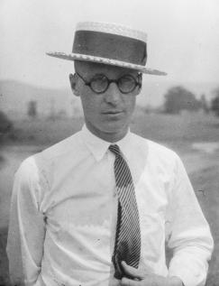
You are John Scopes. You are a secondary school teacher. You came to the school to be a sports coach, but have also been teaching evolution as part of the schools ‘general Science’.
This has broken the ‘Butler’s Law’ in Tennessee. But you know that other students in the US have been learning about evolution.
“I was doing my Job, educating young people about the world around them- why should they know less just because they live in Tennessee?”
Smithsonian Institution Photo: Watson Davis
John Scopes- The Defendant
© 2025. ASE & Big Ideas for RE
Notes:
https://upload.wikimedia.org/wikipedia/commons/6/65/John_t_scopes.jpg

Slide 9
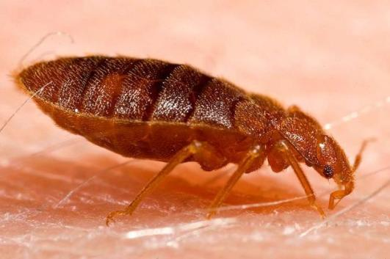
Understanding evolution
© 2025. ASE & Big Ideas for RE

Slide 10
Big Idea 6 in RE: ‘The Big Picture’
Grand narratives & worldviews
Genres of literature & interpreting text
Creation & Creation-ism
Origins of life in different worldviews.
© 2025. ASE & Big Ideas for RE
Notes:
Photo: https://as2.ftcdn.net/jpg/01/09/85/93/220_F_109859341_ZGgrxdSkDpR3izHLB8SD3KKZ1YQExaJN.jpg Creative Commons

Slide 11
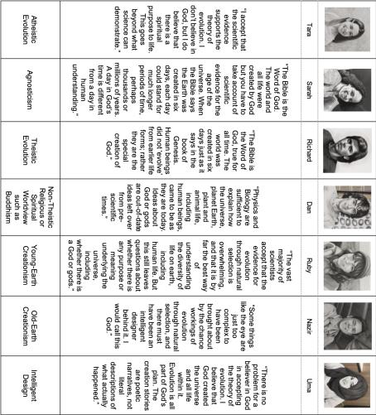
Sample activity
Matching exercise:
‘Creation and Evolution: Where do you stand?’
© 2025. ASE & Big Ideas for RE

Slide 12
Social Darwinism
1925 concern that accepting evolution means replacing values of love and compassion with selfish ‘survival of the fittest’
1940s Germany: Nazi extermination of ‘inferior’ people, including those with disabilities
Challenging this narrative, e.g. Chris McCausland
© 2025. ASE & Big Ideas for RE
Notes:
Left: Photo: Hitler – https://commons.wikimedia.org/wiki/File:Adolf_Hitler_cropped_restored_3x4.jpg / This file is licensed under the Creative Commons Attribution-Share Alike 3.0 Germany license: Bundesarchiv, Bild 183-S33882 / CC BY-SA 3.0 DE.
Right: Photo: Chris McCausland: https://x.com/bound_andgagged/status/1067778386439938050?lang=ar

Slide 13
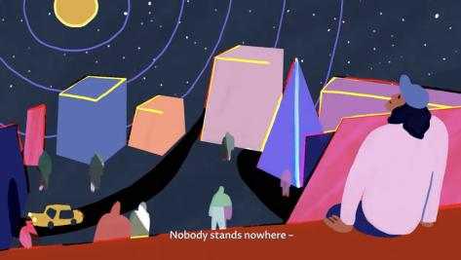
Students’ own worldviews
“Nobody stands nowhere”: Theos short film
Students’ worldview can affect their learning in all subjects
Need to reflect on our own worldview and where it comes from
What can we ALL agree on?…..
© 2025. ASE & Big Ideas for RE
Notes:
Still from Theos Think Tank film: ‘Nobody Stands Nowhere’ by Emily Downe in partnership with Culham St Gabriel’s Trust (CSTG): https://www.youtube.com/watch?v=SXXj_YB--_g

Slide 14
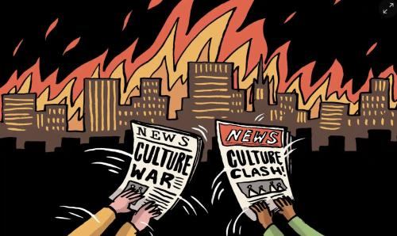
Why Scopes is still important
Continuing issues / ‘culture wars’….
Evolution & science today
School curriculum – USA & UK
Illustration: Dom McKenzie/The Observer
© 2025. ASE & Big Ideas for RE
Notes:
Illustration: Dom MacKenzie/The Observer. https://www.theguardian.com/commentisfree/2020/jun/21/culture-wars-risk-blinding-us-to-just-how-liberal-weve-become-in-the-past-decades

