Slide 1
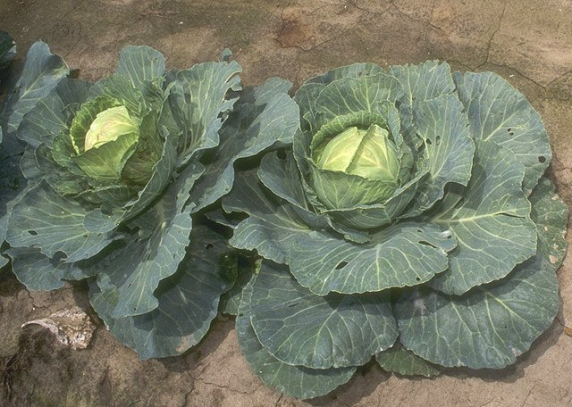
Contaminated Crops
This resource has been developed by the Association for Science Education for their RCUK-funded series
‘Research focused teaching resources to inspire students in STEM Careers’
Notes:
By Bill Tarpenning (http://www.usda.gov/oc/photo/96cs1134.htm) [Public domain], via Wikimedia Commons
https://commons.wikimedia.org/wiki/File:Cabbage.jpg

Slide 2
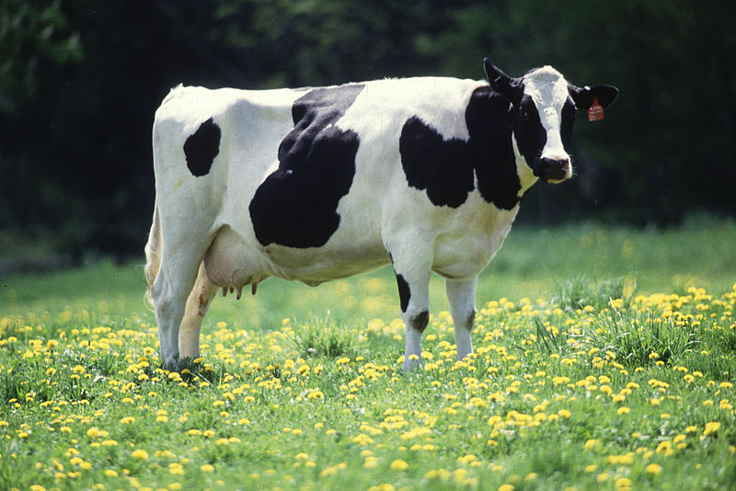
The global research context
As the human population increases more land is needed to grow crops that are either eaten directly by humans or used as feed for animals.
It may become necessary to grow crops on land that has been contaminated by industrial activity or improper disposal of waste.
Identifying crop cultivars which absorb lower levels of dangerous radioactive isotopes, or trace elements, than other cultivars, may contribute to achieving food security in areas previously considered unsuitable for growing crops.
The UN Sustainable Development Goals, January 2016, include halting and reversing land degradation, and restoring and promoting the sustainable use of terrestrial ecosystems.
Notes:
By Keith Weller/USDA (www.ars.usda.gov: Image Number K5176-3) [Public domain], via Wikimedia Commons
https://commons.wikimedia.org/wiki/File:Cow_female_black_white.jpg
H: minor re-wording in this text
The UN Sustainable Development Goals, January 2016, include halting and reversing land degradation, and restoring and promoting the sustainable use of terrestrial ecosystems.

Slide 3
Your BIG Research Question
What scientific research could help to reduce the human intake of radioactive isotopes from crops grown in contaminated areas?
Notes:
Photo Credit By Elena Filatova [Public domain], via Wikimedia Commons
https://commons.wikimedia.org/wiki/File:Chernobylpowerplantradioactivity.jpg

Slide 4
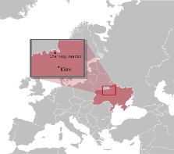
The Chernobyl disaster
Glossary
The Brassica oleracea species includes vegetables such as broccoli, cauliflower, kale, cabbage and sprouts.
A cultivar is a plant variety that has been produced by selective breeding for desired characteristics.
On 26 April 1986, an explosion and fire at the Chernobyl Nuclear Power Plant released radioactive particles into the atmosphere which spread across Europe.
The area around the nuclear power plant was heavily contaminated by a range of radioactive isotopes. Local people were evacuated and an exclusion zone exists around the site to this very day. Two isotopes found in soil in the Chernobyl Exclusion Zone are ¹³⁷Cs and ⁹⁰Sr . They were originally formed inside the nuclear reactor. Scientists are researching ways to reduce human intake of these isotopes through the food chain.
Questions…
Atoms of ¹³⁷Cs and ⁹⁰Sr turn into ions in the soil. Use a diagram to explain how these radioactive ions are taken up by plants.
Some plants are used for phytoextraction. Explain why it is important that the plants used have good uptake of the metal ions being extracted.
Explain why this research is focused on finding out whether some plants have a reduced uptake of ¹³⁷Cs and ⁹⁰Sr ions.
How did the scientists ensure a fair comparison between cultivars grown in the different pots?
Brassicas are not the main contributor to human uptake of radioactive isotopes in the diet. Suggest what other plants could be the focus of further research.
Research summary
Scientists mixed a solution of CsCl (containing Cs isotopes) with potting compost for 2 minutes using a large food mixer. Pots of the same size were filled to 9 cm depth with the compost. Seeds from 27 different cultivars of Brassica oleracea were planted and the pots kept under controlled light conditions at constant temperature. After 40 days compost samples and shoot samples were dried and the concentration of Cs isotopes measured.
Now investigate your Big Research Question...
What scientific research could help to reduce the human intake of radioactive isotopes from crops grown in contaminated areas?
Notes:
Photo reference and credit:
https://en.wikipedia.org/wiki/Chernobyl_disaster#/media/File:Chernobyl_placement.svg
"Chernobyl placement” This Wikipedia and Wikimedia Commons image/multimedia is from the user Holek and is freely available at //commons.wikimedia.org/wiki/File:Chernobyl_placement.svg under the creative commons cc-by-sa 2.5 Poland license.

Slide 5
3
Going deeper…
Glossary
A morphotype of the Brassica oleracea species has its own distinctive external features. Stems, leaves and flowers may all have different shapes and sizes, even within the same species.
Some results, adapted from the research, are presented in the table below. They show radioactivity levels from the ¹³⁴Cs isotope (¹³⁷Cs is only produced inside a nuclear reactor).
1. For each of the kale results calculate the ratio of the plant radioactivity level to the soil radioactivity level (plant radioactivity level/ soil radioactivity level). This is known as the concentration ratio and allows scientists to compare plant cultivars fairly, even where soil levels of the Cs isotope vary.
2. Calculate the mean result for each cultivar of kale and the overall mean for kale.
Kale cultivar | Soil radioactivity level* | Plant shoot radioactivity level * | Concentration ratio | Mean
Kale 1 | 0.020 | 0.0050
Kale 1 | 0.023 | 0.0073
Kale 1 | 0.021 | 0.0068
Kale 2 | 0.032 | 0.0054
Kale 2 | 0.019 | 0.0061
Kale 2 | 0.016 | 0.0048
Overall mean
3. Kale, Brussels sprouts and broccoli are all different morphotypes of the Brassica oleracea species. The mean concentration ratio for broccoli was 0.51 and for Brussels sprouts was 0.36.
a. List the three vegetables in order of uptake of ¹³⁴ Cs from lowest to highest.
b. Suggest why the order of ¹³⁴Cs levels consumed when the vegetables are eaten may differ from your list above. You should include comments on differences in the morphology of the fully grown plants in your answer.
c. What else might scientists research to find out more about ¹³⁴Cs level differences in mature plants?
* Measured in kiloBecquerel per gram of dry material.

Slide 6
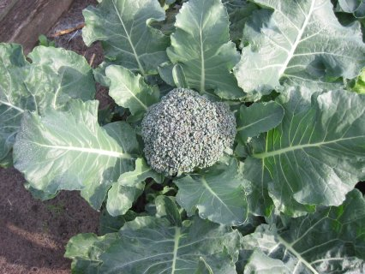
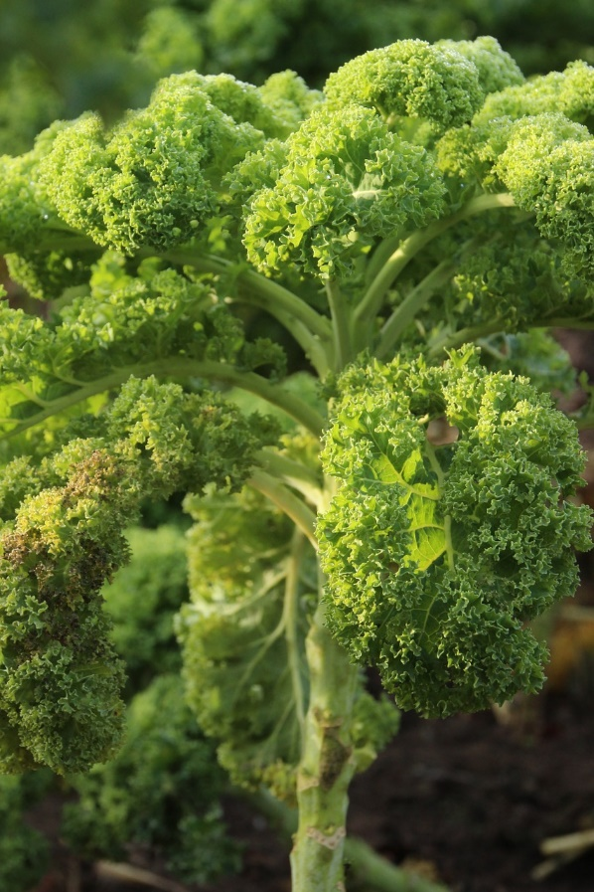
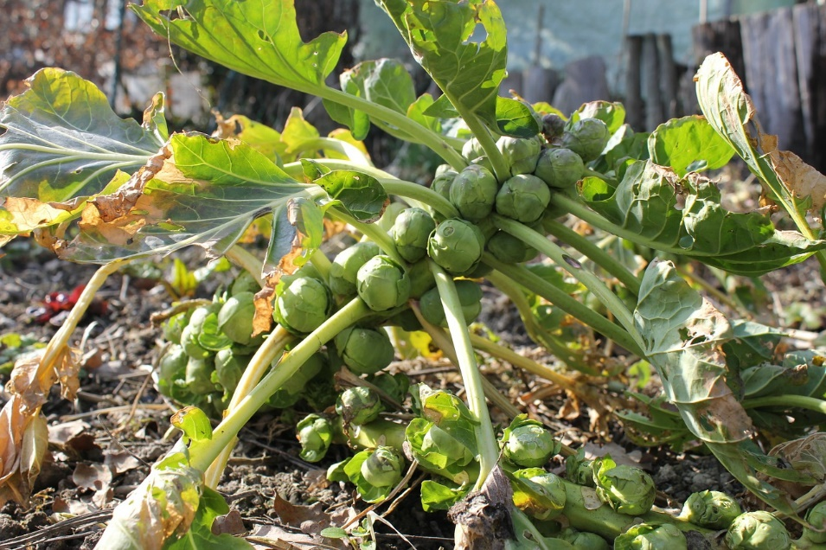
Broccoli, Brussels sprouts and kale growing in the field.
Curly kale – one of several varieties of kale.

Slide 7
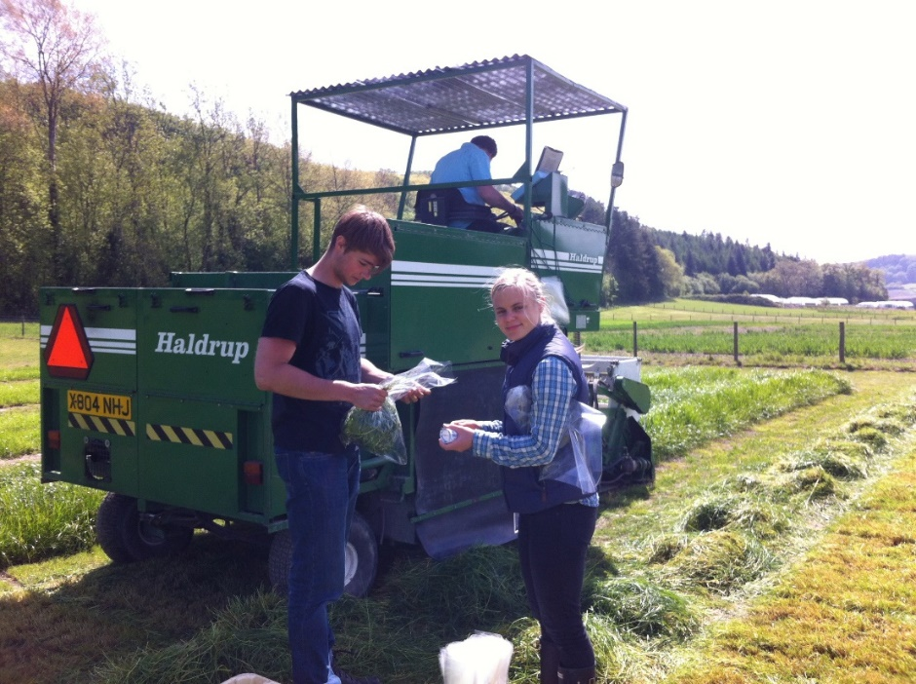
Where can science research take you?
Dr Beth Penrose is a plant scientist at the NERC Centre for Ecology and Hydrology and the University of Nottingham.
Her research is focused on plant nutrition and involves field work, lab work, computer programming, statistics and writing scientific papers.
For more information on science and STEM careers see www.futuremorph.org.
For video clips illustrating a broad range of science careers relating to the natural environment see www.schoolscience.co.uk/nercyoutube.
Videos feature a geologist, environmental physicist, an ecologist amongst others.
Notes:
Photo courtesy of Dr Beth Penrose

Slide 8
Useful links
Further information
This BBC news article about the nuclear accident at Fukushima may be used to show students how the contamination of crops via radioactive fallout is a repeated problem in nuclear accidents.
Students may benefit from being given some background information on the Chernobyl disaster.
Watch and listen to scientist Dr Beth Penrose’s presentation describing her research into radioactive uptake by different grass cultivars.
‘Can low accumulating cultivars of forage grass reduce transfer of radioactive contaminants?’
The University of Nottingham runs a Plant and Crop Science Summer School for Year 11 students.

Slide 9
Useful links
Other resources from NERC…
Planet Earth Magazine
News articles and podcasts produced by NERC on research news from the natural world which could be used to bring cutting-edge research to the classroom.
Beyond the Gardens: The Crop Wild Relatives Project
In this video, scientists from Kew Garden's Millennium Seed Bank and teams from around the world share their work collecting wild specimens to widen the genetic diversity available for our major crop plants.

Slide 10
Acknowledgements
Research paper
B. Penrose ^{1,2}, K.A. Johnson (née Payne) ^{2,3} A Arkhipov ⁴, A. Maksimenko ⁵, S. Gaschak⁵, M.C. Meacham², N.J.M. Crout ², P.J.White ^{6,7}, N.A.Beresford ¹, M.R.Broadley ² ‘ Inter-cultivar variation in soil-to-plant transfer of radiocaesium and radiostrontium in Brassica oleracea’
¹ NERC Centre for Ecology and Hydrology
² University of Nottingham
³ Horticulture Research International (now University of Warwick)
⁴ Independent researcher, Kiev, Ukraine
⁵ Chornobyl Center for Nuclear Safety, Radioactive Waste and Radioecology
⁶ The James Hutton Institute, Invergowrie, Dundee
⁷ Distinguished Scientist Fellowship Program, King Saud University, Kingdom of Saudi Arabia
Organisations
Research project funded by
NERC
NERC Centre for Ecology and Hydrology
University of Nottingham

