Slide 1
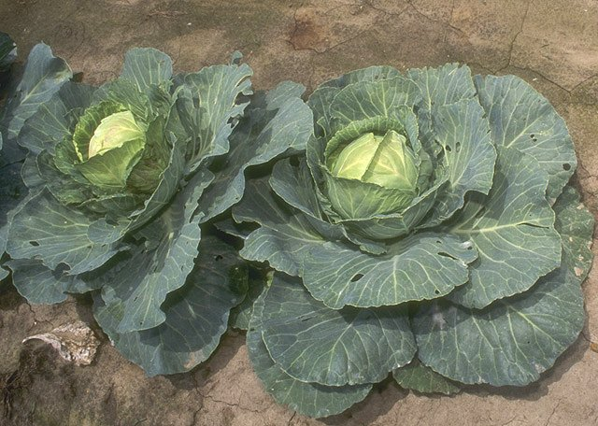



Contaminated Crops
This resource has been developed by the Association for Science Education for their RCUK-funded series
‘Research focused teaching resources to inspire students in STEM Careers’
Notes:
By Bill Tarpenning (http://www.usda.gov/oc/photo/96cs1134.htm) [Public domain], via Wikimedia Commons
https://commons.wikimedia.org/wiki/File:Cabbage.jpg

Slide 2

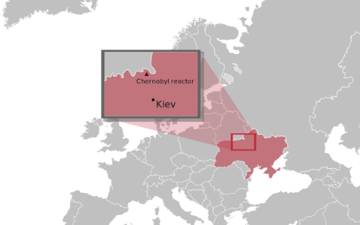
Research insight…
Weblink to be added shortly once research paper published.
Curriculum keywords
phytoextraction, ion, isotope, minerals, roots
Teacher answers to SS1 questions
Metal ions that are dissolved in water in the soil may be absorbed by plants through the roots. These metals ions can then accumulate in the roots, shoots or leaves of the plant.
The aim of phytoextraction is remove metal ions from contaminated areas (e.g. mining waste); it is important to select plants that have a good uptake of the metal ions which need to be removed.
In areas contaminated by radioactive isotopes it is important to reduce human intake through the food chain. Therefore this research aims to find out whether there are some cultivars of brassica with poor uptake because the accumulation of radioactive ions in these plants will be less, thereby reducing the amount ingested by humans.
The soil and CsCl were well mixed for uniform distribution of the radioactive ions. The soil depth was kept the same as was the size of pot. Growing conditions (light and temperature) were kept the same and the samples for analysis were all taken the same number of days after the seeds were sown. Please note that the research paper gives more detail on the method and that this text provides a summary of the key points for students.
Answers could include staple food crops such as potato, or crops used as animal feed. Milk is a key method of intake into the food chain, so the grass eaten by cows is also significant.
The BIG Research Question explanation
Scientific research into the uptake of radioactive Cs and Sr by different cultivars of food crop may be used to potentially identify varieties with reduced uptake. These cultivars could then be planted in contaminated areas and reduce either the direct intake by humans or the intake by animals that are either eaten by humans or whose milk is consumed.

Slide 3

Going deeper: Teacher Guidance and answers (SS2)
1 and 2 See table below
3a. From lowest to highest, the order of ¹³⁴Cs levels in the shoots sampled was kale, Brussels sprouts, broccoli.
3b. The levels of ¹³⁴Cs consumed when the mature plants are eaten will depend upon the quantities that accumulate in different parts of the plant (leaves, stem, flowers). The morphology of the three plants differs, as does the part of the plant primarily consumed (e.g. the flower of broccoli but the leaves of kale) so the order of ¹³⁴Cs intake may differ to the amount found in the shoots of the plant during the experiment.
3c. Scientists could also research where the ¹³⁴Cs isotope accumulates in mature plants or how ¹³⁴Cs is transported into and through the plants.
Kale cultivar | Soil radioactivity level* | Plant shoot radioactivity level * | Concentration ratio | Mean
Kale 1 | 0.020 | 0.0050 | 0.025 | 0.22
Kale 1 | 0.023 | 0.0073 | 0.032
Kale 1 | 0.021 | 0.0068 | 0.032
Kale 2 | 0.032 | 0.0054 | 0.17 | 0.27
Kale 2 | 0.019 | 0.0061 | 0.32
Kale 2 | 0.016 | 0.0048 | 0.33
Overall mean |  |  |  | 0.25

Slide 4
Extension
Advanced-level students could be asked to research and explain in more depth possible reasons for the difference in uptake between the kale, Brussels sprouts and broccoli analysed.
Most K⁺ transport mechanisms in plants are selective, so the relationship between K⁺ uptake and ¹³⁴Cs⁺ uptake is not directly proportional. This contrasts with the less specific transport of Ca²⁺, which means that uptake of Sr²⁺ is proportional to uptake of Ca²⁺. Therefore, an explanation could be that the broccoli may have a higher proportion of non-selective to selective K⁺ transporters and therefore does not discriminate against Cs⁺ in favour of K⁺ as much as the Brussels sprouts.
Another explanation could be that K⁺ is used in stomatal activity. Stomatal opening is controlled by the flux of K⁺, and therefore it may be that there is more K⁺ in the broccoli plant, because the leaves are larger. (see https://www.ipni.net/ppiweb/bcrops.nsf/$webindex/84CBB51751971AB3852568F000673A10/$file/98-3p04.pdf for more details)
In addition to this, K⁺ improves the shelf life of many vegetables; it might be that because the leaves are often kept on broccoli (but not on Brussels sprouts), then they have been bred to have higher K⁺ concentrations in their leaves, and this might cause there to be a higher concentration of K⁺-like cations such as Cs⁺ .

Slide 5
Useful links
Further information
This BBC news article about the nuclear accident at Fukushima may be used to show students how the contamination of crops via radioactive fallout is a repeated problem in nuclear accidents.
Students may benefit from being given some background information on the Chernobyl disaster.
Watch and listen to scientist Dr Beth Penrose’s presentation describing her research into radioactive uptake by different grass cultivars.
‘Can low accumulating cultivars of forage grass reduce transfer of radioactive contaminants?’
The University of Nottingham runs a Plant and Crop Science Summer School for Year 11 students.

Slide 6
Useful links
Other resources from NERC…
Planet Earth Magazine
News articles and podcasts produced by NERC on research news from the natural world which could be used to bring cutting-edge research to the classroom.
Beyond the Gardens: The Crop Wild Relatives Project
In this video, scientists from Kew Garden's Millennium Seed Bank and teams from around the world share their work collecting wild specimens to widen the genetic diversity available for our major crop plants.

Slide 7
Acknowledgements
Research paper
B. Penrose ^{1,2}, K.A. Johnson (née Payne) ^{2,3} A Arkhipov ⁴, A. Maksimenko ⁵, S. Gaschak⁵, M.C. Meacham², N.J.M. Crout ², P.J.White ^{6,7}, N.A.Beresford ¹, M.R.Broadley ² ‘ Inter-cultivar variation in soil-to-plant transfer of radiocaesium and radiostrontium in Brassica oleracea’
¹ NERC Centre for Ecology and Hydrology
² University of Nottingham
³ Horticulture Research International (now University of Warwick)
⁴ Independent researcher, Kiev, Ukraine
⁵ Chornobyl Center for Nuclear Safety, Radioactive Waste and Radioecology
⁶ The James Hutton Institute, Invergowrie, Dundee
⁷ Distinguished Scientist Fellowship Program, King Saud University, Kingdom of Saudi Arabia
Organisations
Research project funded by
NERC
NERC Centre for Ecology and Hydrology
University of Nottingham

