Slide 1
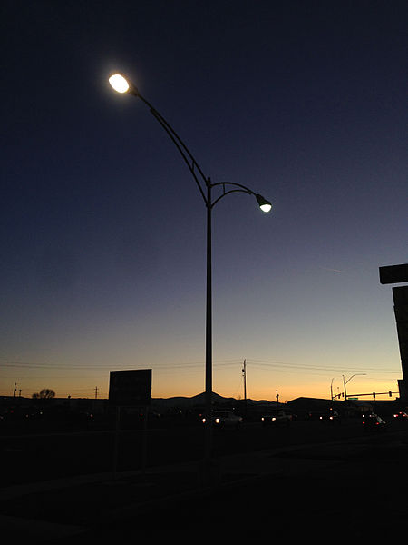



Lighting the Night
This resource has been developed by the Association for Science Education for their RCUK-funded series
‘Research focused teaching resources to inspire students in STEM Careers’
Notes:
Photo: By Famartin (Own work) [CC BY-SA 4.0 (http://creativecommons.org/licenses/by-sa/4.0)], via Wikimedia Commons

Slide 2
The global research context
Lighting the night
Street lights make pedestrians feel safer at night, and cut crime.
Street lights rely on electricity. In the UK, most electricity is generated by burning fossil fuels, resulting in carbon dioxide emissions.
Can we keep street lights bright enough to make people feel safe, but reduce their demand for energy, so cutting greenhouse gas emissions?
Photo:
Scientists funded by the Economic and Social Research Council (ESRC) have made great progress in solving this problem.
Notes:
Photo: By Famartin (Own work) [CC BY-SA 4.0 (http://creativecommons.org/licenses/by-sa/4.0)], via Wikimedia Commons

Slide 3
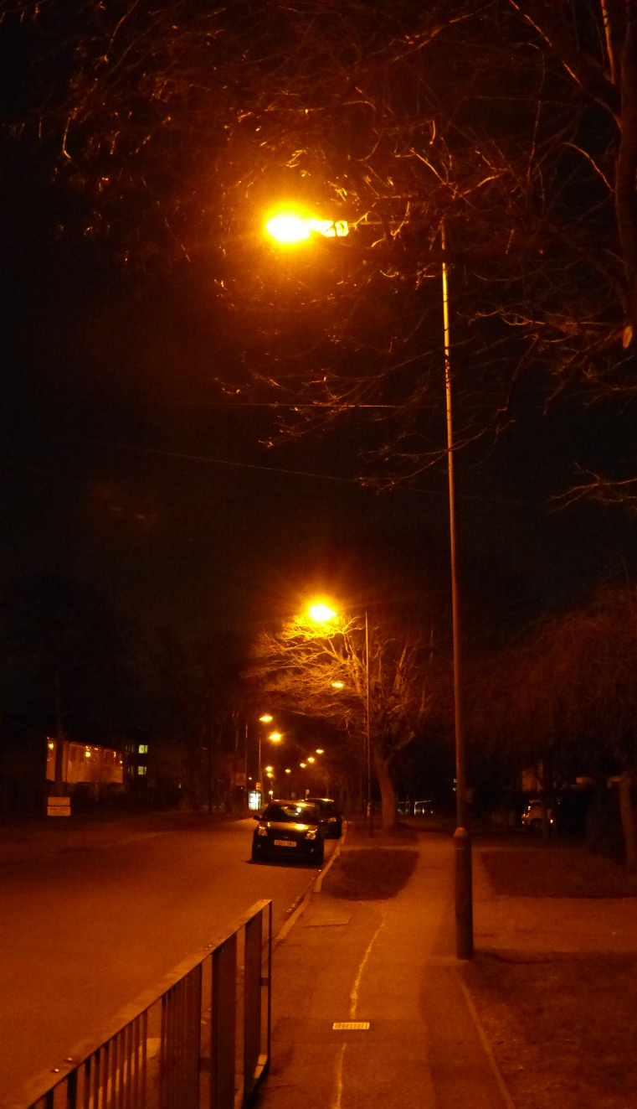
Your BIG Research Question
How can street lighting make people feel safe
as well as reducing energy demand and greenhouse gas emissions?
Notes:
Photo: Helen Harden

Slide 4

Research summary¹
‘One of they key tasks for a pedestrian walking along a road at night is to recognise other pedestrians and work out if they present a threat, before they are so close that no evasive action can be taken.
In order to see if white light is better than light from orange sodium lamps we did an experiment into facial recognition distances under various light sources.’
The scientists hoped to find out whether a different type of street light, which transfers less energy, would allow pedestrians to recognise faces at a distance of 4 m. Being able to recognise faces at this distance helps people to feel safe.
The experiment
The scientists blacked out a big room and lit it with two compact fluorescent lamps (CFL). This type of lamp emits white light.
Then a person (the observer) walked towards another person (the subject) until the observer could recognise the subject’s face. The scientists wrote down the recognition distance.
The scientists changed the brightness of the lamps and repeated the experiment. They then did the experiment again with different types of light.
The diagram and photo on Student Sheet 1b show the experimental set up.
Questions…
Draw and label a diagram to explain how a street light helps you to see another pedestrian at night.
Why it is harder to recognise colours in orange light than in white light? Use these facts to help you explain.
  White light is made up of light of different colours.
  The waves in white light have a wide range of frequencies.
  The waves in light of one colour, for example orange, have a narrow range of frequencies.
  A coloured object reflects light of its own colour and absorbs light of other colours.
Look at the graph on Student Sheet 1b.
  For the sodium lamp, describe the impact of reducing the luminance (light brightness) on the recognition distance.
  For each type of light, write down the relative luminance needed to recognise a face that is 4 m away.
Look at the data in the table on Student Sheet 1b. Which lamps transfer least energy in a given time?
Now investigate your Big Research Question...
How can street lighting make people feel safe as well as reducing energy demand and greenhouse gas emissions?
¹ Raynham, P and Sakswikrønning. (2003) ‘White light and facial recognition’, The Lighting Journal 68 (1): 29-33.

Slide 5

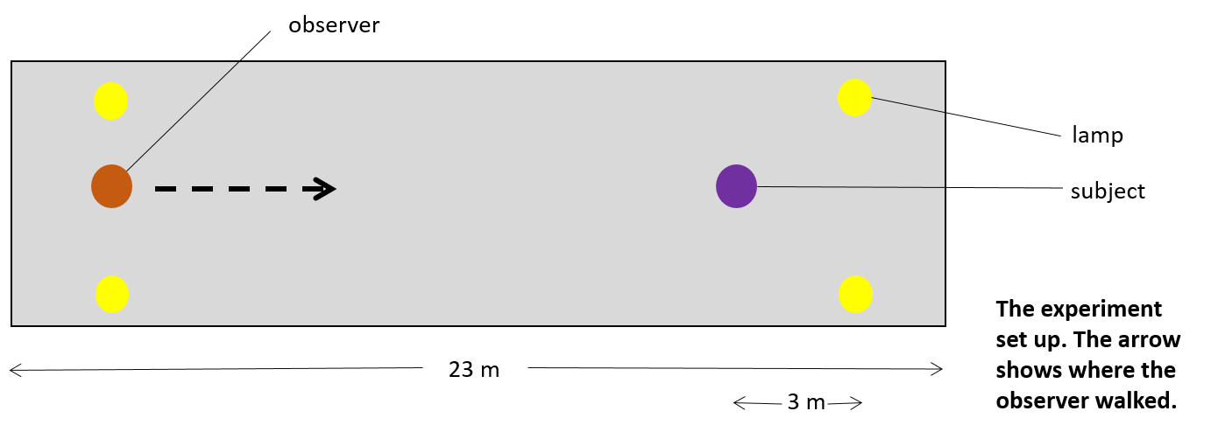
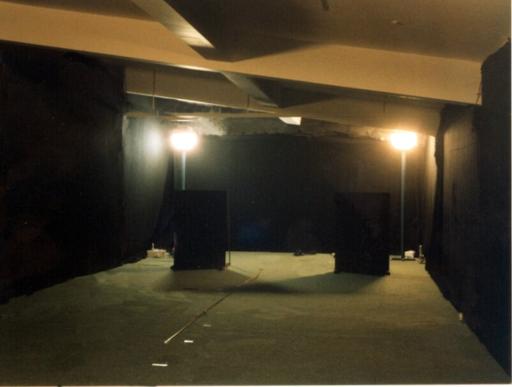
Type of lamp | Lamp power rating (W)
sodium lamp | 70 W
CFL (A) | 42 W
CFL (B) | 42 W
Power rating of lamps used in the experiment
Graph of relative luminance versus recognition distance.
The room
Notes:
Thank you Peter Raynham for permission to include the photograph and graph.

Slide 6

Going deeper…
The values for facial recognition distance are average values – the scientists found the mean distance for eight people.
The scientists noticed that the individual observers had very different performances, so they asked a second question: ‘Does age affect facial recognition distance?’
To answer this question, they divided their data to show recognition distances for two age groups:
  20 to 30
  45 and over
Relative illuminance
The scientists then plotted the data separately on the graph above.
Questions…
Some older people feel unsafe when walking in the dark. How does data from the graph help to explain this?
Suggest two changes that local councils could make to street lighting to make pedestrians feel safer at night.
Notes:
Thank you to Peter Raynham for permission to include the graph

Slide 7
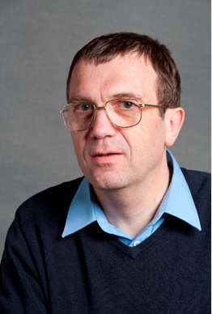

Where can science research take you?
Scientists at the Institute for Environmental Design and Engineering at University College London (UCL) did this research, which was funded by the Economic and Social Research Council (ESRC).
Peter Raynham led the research, joined by his colleague Torrun Saksvikrønning. Peter worked for 20 years in the lighting industry. He is now a lecturer at UCL; he also chairs the British Standards committee on light and lighting.
For more information on science and STEM careers see www.futuremorph.org.
Notes:
Photo: Included with kind permission from Peter Raynham

Slide 8
Useful links
Further information
RCUK energy programme – this web page outlines the importance of the energy research funded by the research bodies of the Research Councils UK. The link to the impact of energy research is particularly useful.
Peter Raynham – this web page includes a biography of the scientist who led the research.
News about research in Granada, Spain – this article on Physics.org describes the benefits of white street lighting, and includes a link to a recent research article.
Resources from the Economic and Social Research Council
ESRC YouTube channel – this channel describes the diverse work of social scientists around the world, and has several useful videos relevant to school science.
ESRC public engagement – this page showcases the wide range of issues tackled by the ESRC. The section Social Science for Schools includes a useful series of resources on environmental science.

Slide 9
Acknowledgements
Research paper
This resource is based on the research paper
Raynham, P and Sakswikrønning. (2003) ‘White light and facial recognition’, The Lighting Journal 68 (1): 29-33. It is available here.
Thank you to Peter Raynham for permission to use the diagrams, photographs and graph on slides 5 and 6.
Organisations
The research was funded by the Economic and Social Research Council.
Peter Raynham is a senior lecturer at the University College London (UCL) Institute for Environmental Design and Engineering.

