Slide 1
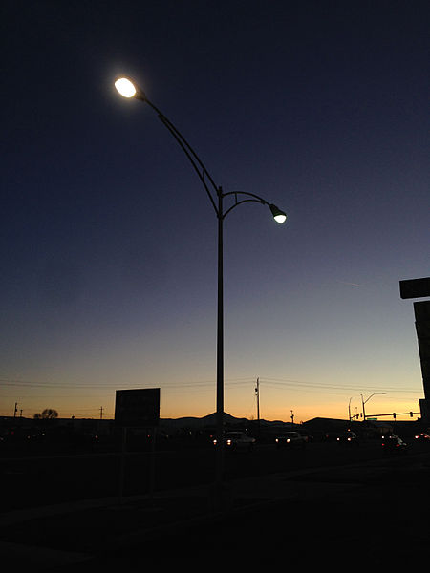



Lighting the Night
This resource has been developed by the Association for Science Education for their RCUK-funded series
‘Research focused teaching resources to inspire students in STEM Careers’
Notes:
Photo: By Famartin (Own work) [CC BY-SA 4.0 (http://creativecommons.org/licenses/by-sa/4.0)], via Wikimedia Commons

Slide 2
How to use this resource…
Use this resource…
at the start of a topic to…
  engage students in a real life context relating to current research
  to find out what students already know
  consolidate existing understanding
at the end of a topic to…
  assess student understanding by challenging students to apply their learning to a new context
  to provide a contemporary example of how scientists are pushing the boundaries in understanding a subject area further
  add depth and challenge
within a topic to…
  enhance students’ confidence in the analysis of data by providing the opportunity to work with data types beyond those obtained in the school laboratory
  assess student understanding of specific aspects of working with data (working scientifically by applying their understanding in a new context)
as an independent learning activity
to promote careers in STEM and show the varied work of scientists

Slide 3
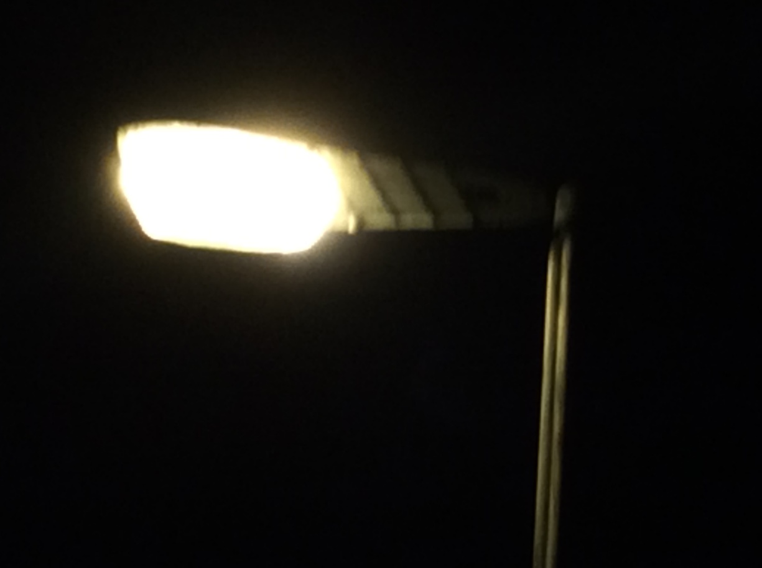

Research insight…
For an article detailing the impact of the work, see research impact.
Curriculum keywords
Light, colour, ray
Teacher answers to SS1 questions
Diagram showing a ray of light (straight arrow) going from the light to the subject, with a second ray of light (straight arrow) going from the subject to the observer’s eye.
White light is made up of light of different colours. In white light, light of all these colours is reflected from the subject’s face, meaning that all colours can be seen. Seeing a full range of colours is important for recognising faces. In orange light, only orange light is reflected from the subject’s face; light of other colours is absorbed. This means that the observer cannot see the subject’s face in full colour, meaning that facial recognition is more difficult.
a) For the sodium lamp, the lower the value of luminance, the shorter the recognition distance.
b) For the sodium lamp, relative luminance needed for a recognition distance of 4 m = 2.7; for white light A the relative luminance = 0.6 and for white light B the relative luminance = 0.8
The compact fluorescent lamps (white) have a lower power rating than the orange lamp. This means that they transfer less energy in a given time.
The BIG Research Question explanation
For a facial recognition distance of 4 m, the minimum for pedestrians to feel secure at night, the required luminance (brightness) is lower for a white lamp than for an orange sodium lamp.
The power rating of the white lamps used in the experiment is lower than that of the orange sodium lamp. In a given time, a lamp with a lower power rating transfers less energy than a lamp with a higher power rating. This means that the white lamps transfer less energy. This reduces demand for electricity for a given level of lighting. Since most electricity in the UK is generated by burning fossil fuels, reducing the demand for electricity reduces carbon dioxide emissions. Carbon dioxide is a greenhouse gas.
Notes:
Photo: Catherine Gardom

Slide 4

Researchers’ impacts
The ESRC, which funded the research, points out that this work shows that the same lighting benefits as traditional orange sodium lighting could be achieved using white lighting with lower illuminance, giving the same facial recognition distances.
These findings led to the adoption of white light in residential roads and urban centres throughout the UK, saving 113 gigawatts of electricity and over £10 million costs for 2012, as well as reducing UK carbon dioxide emissions by an estimated 45.5 megatonnes.
The use of white lighting has grown from 450 000 units in 2008 to about
1 450 000 in 2012, and has continued to increase since 2012.
Teacher Guidance and answers to SS2
On the graph, the line for ages 45+ is to the right of the line for younger observers, showing that people in the older age group need a greater illuminance (about 1 unit) for a facial recognition distance of 4 m.
Local councils could provide brighter lighting to improve illuminance, or switch from orange lighting to white lighting.
Notes:
Photo: By Famartin (Own work) [CC BY-SA 4.0 (http://creativecommons.org/licenses/by-sa/4.0)], via Wikimedia Commons

Slide 5
Useful links
Further information
RCUK energy programme – this web page outlines the importance of the energy research funded by the research bodies of the Research Councils UK. The link to the impact of energy research is particularly useful.
Peter Raynham – this web page includes a biography of the scientist who led the research.
News about research in Granada, Spain – this article on Physics.org describes the benefits of white street lighting, and includes a link to a recent research article.
Resources from the Economic and Social Research Council
ESRC YouTube channel – this channel describes the diverse work of social scientists around the world, and has several useful videos relevant to school science.
ESRC public engagement – this page showcases the wide range of issues tackled by the ESRC. The section Social Science for Schools includes a useful series of resources on environmental science.

Slide 6
Acknowledgements
Research paper
This resource is based on the research paper
Raynham, P and Sakswikrønning. (2003) ‘White light and facial recognition’, The Lighting Journal 68 (1): 29-33. It is available here.
Organisations
The research was funded by the Economic and Social Research Council.
Peter Raynham is a senior lecturer at the University College London (UCL) Institute for Environmental Design and Engineering.

