Slide 1
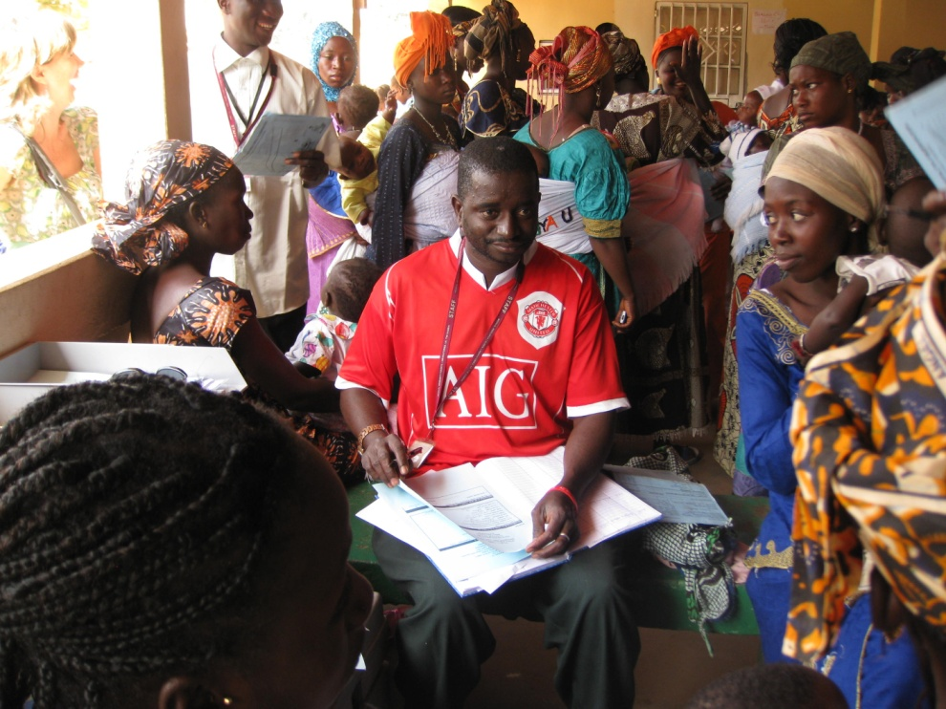



Protecting Communities in Africa from Pneumococcus
This resource has been developed by the Association for Science Education for their RCUK-funded series
‘Research focused teaching resources to inspire students in STEM Careers’
Notes:
Photograph: Beate Kampmann

Slide 2
How to use this resource…
Use this resource…
at the start of a topic to…
  engage students in a real-life context relating to current research into the development and use of medicines
  to find out what students already know about the causes and transmission of disease
  consolidate existing understanding on immunity and vaccination
at the end of a topic to…
  assess student understanding by challenging students to apply their learning to a new context
  to provide a contemporary example of how scientists are pushing the boundaries in understanding a subject area further
  add depth and challenge to ‘working scientifically’
within a topic to…
  enhance students’ confidence in the analysis of data by providing the opportunity to work with data types beyond those obtained in the school laboratory
  assess student understanding of specific aspects of working with data (working scientifically) by applying their understanding in a new context.
as an independent learning activity
to promote careers in STEM and show the varied work of scientists

Slide 3


Research insight…
For a full summary of this research see MRC The Gambia Unit report
Curriculum keywords
Vaccination, immunity, T-cell, antibody, randomised control trial, sampling
Teacher guidance and answers to SS1a questions
1. A vaccine contains an inactive or harmless strain of the pathogen that does not make the immunised person ill but does introduce antigens into the blood. This causes the production of antibodies that react against antigens found on the pathogen. PCV-7 vaccine contains antigens from seven types of pneumococcus bacteria.
If the pneumococcus bacteria that infected an immunised person contained antigens from one of these seven types of pneumococcal bacteria, there would be an antigen–antibody reaction. This results in antibody binding onto the antigens of the surface of the bacteria. There would be a number of different results including:
The antibody acts as a marker flag so that the bacterium is recognised as foreign and is engulfed by white blood cells.
More antibody proteins are manufactured to fight further infection.
Information about the antibody is stored so that further copies can be made in case of future infections.
2. In 1999, there were approximately 88 cases per 100 000 of the population aged under 5 years, and 66 cases per 100 000 aged over 65 years.
3. In 2004, five years later, there were 20 cases per 100 000 of the population under 5 years, and 40 cases per 100 000 of the population over 65 years.
4. The vaccine was most effective in the infant population.
Note for teachers: The impact of this vaccine on infant infection rates was evidence for vaccinating all infants in the research trial in The Gambia, irrespective of whether they lived in the experimental or control villages.
Notes:
Photograph: Beate Kampmann

Slide 4
Teacher guidance and answers to SS1b questions
1. Students should answer this question based on their own experience of practical techniques in school
Take a swab from the area to be sampled using sterile cotton wool or other sterile methods.
The swab should be wiped over sterile agar in a Petri dish so that only bacteria from the swab are inoculated. The swab should then be sterilised by placing in disinfectant. The Petri dish needs to be labelled and then incubated at temperatures lower than human blood temperature to prevent the growth of human pathogen bacteria. Remove the dish from the incubator once colonies can be seen.
Information about culturing samples during the trial by scientist Dr Anna Roca
‘We use the swab cotton and keep it inside a tube containing a liquid that is a bacterium protector. Once in the lab, we do not use the swab cotton and take specific microliters of the liquid in the tube to inoculate the Petri dish.
We need to standardise the methodology to be able to compare arms. We place all the Petri dishes for exactly the same length of time in the incubator (24 or 48 hours depending on the study). Otherwise, we would be introducing bias as, for example, only the study arm could have been longer in the incubator.
Microscopes are used when cerebrospinal fluid is collected among sick patients with suspected meningitis to identify if there are any bacteria in fluids, which should be totally clean. When collecting swabs, the microscope is not used.’

Slide 5
Teacher guidance and answers to SS1b questions continued
2. Pneumococcal bacteria are spread from person to person by sneezing and coughing. One individual may infect numerous other people. Each of those people will in turn infect more people resulting in the disease spreading rapidly through a community.
If a person has been vaccinated they are immune from the disease, which means that not only will they not catch the disease, they also cannot spread it to other people.
If a large number of people are immune then fewer people will be infected by the disease, but more importantly there is a much reduced chance that a non-immunised person will be infected with the disease because transmission rates are reduced.
This ‘herd effect’ is the subject of the research study which aims to assess the likely reduction of community-wide infection through the introduction of a vaccination programme .
3. A standard randomised control trial records the response at the individual level. A cluster randomised trial looks at the whole group and can therefore measure any herd effect.
More detail from Dr Anna Roca:
By running a cluster randomised trial the research authors hope to speed up the development of a vaccination programme for countries in Africa. The study design is specifically a cluster randomised trial. That is, the unit of randomisation are clusters rather than individuals. In this case, the clusters were villages in rural parts of The Gambia. This design can measure herd effect properly. If you don’t randomise by clusters and only randomise individually (randomised control trial) you can only measure herd effect by comparing the decrease among non-vaccinated before vaccination and after vaccination (ecological study, not randomised trial – less powerful and more prompted to bias).

Slide 6
Teacher guidance and answers to SS1b questions continued
4. By giving a control vaccine rather than no vaccine, the participants are unaware whether they have received PCV-7 vaccine. By keeping the identity of the experimental group and control group secret it is unlikely that either technicians or villagers could knowingly influence the results of the study. This influence can sometimes happen subconsciously. People may change their behaviour by thinking they are protected against certain diseases and put themselves at higher risk making the drawing of valid conclusions difficult.
This was a ‘single blind trial’ rather than a ‘double blind trial’ because the team administering the vaccination programme needed to know who was to receive the two different vaccines (PCV-7 and control vaccine).
5. The data from the United States showed that the PCV-7 was most effective for infants. Pneumococcus can cause several fatal or serious diseases. It was considered unethical to withhold this important vaccine from the most susceptible people in the control groups – infants under 30 months old.
A previous trial in The Gambia also showed that this vaccine saved lives of children less than 30 months of age.
6. Students may come up with a variety of acceptable answers. Possibilities include:
including a large number of villages to give a large sample size; choosing villages located in a single region of The Gambia so that environmental conditions are likely to be similar in all the villages; using a random process to select which villages became the experimental villages; testing for pneumococcal bacteria at several intervals so that patterns in the data could be detected; and testing similar-sized sample groups on each occasion so that there would be similar levels of variability in the results.
Big Research Question
It would help students to go through the answers to the questions (including background information) before they attempt the Big Research Question.
Students should use their answers to the previous questions to write a clear description of the how the trial could be designed. They should include details on the selection of villages, organisation of the control and experimental groups, whether all infants receive the vaccine, and testing for bacteria following the vaccination programme. Students should also give reasons for their decisions.

Slide 7

Teacher guidance and answers to SS2a questions
The numbers of people testing positive for this strain of pneumococcus declined over the course of the study, in both groups of villages and in both age groups.
Children in the vaccinated villages showed a big decrease in the numbers testing positive in the first six months and continued to show a slower decrease over the remaining months of the study. Adults also showed a big decrease in the first six months although there were fewer adults testing positive at the start of the study. After 22 months the numbers of adults testing positive had fallen to zero.
Children in the control group showed a big decrease in the numbers testing positive after six months but then the numbers stayed constant for the rest of the study. Adults in the control group also showed a big decrease in positive tests after six months, and again the numbers then remained constant or showed a small increase.
In both the control and experimental villages the prevalence of pneumococcus was higher before the study began than in the months (6, 12, 22) following it. In the first six months after vaccination there was a large decrease in numbers testing positive. After six months there was little change in numbers testing positive in the control village and only a very small change in the experimental village.
In vaccinated villages, the fall in percentage of children testing positive was due to the direct effect of the vaccine increasing immunity to pneumococcus. In the control communities, the numbers of children and adults testing positive for pneumococcus went down even though these people had not been vaccinated with PCV-7. This is attributed to the ‘herd effect’ or indirect effect of the vaccine. Infants in the control villages had received vaccinations of PCV-7. They were resistant to being infected and blocked transmission of the bacteria to other people, so fewer adults and children tested positive than at the start of the study. This ‘herd effect’ means that to protect a whole community against an infection, it may only be necessary to vaccinate those responsible for transmitting the infection to the community (usually young children). In this study the herd effect is quite strong because the differences in the two sets of results are not big.
In both groups of villages, more children tested positive for pneumococcus than adults. The immune system contains white blood cells that retain copies of most of the types of antibody that have been produced in the life of the individual. If an infection occurs a second time this means that antibodies of the correct configuration can be quickly produced in large numbers so that the second infection can be reduced in severity. Throughout childhood people are exposed to many different strains of pneumococcus and will build up immunity, and therefore will be less likely to test positive for these strains of pneumococcus as adults.

Slide 8
Teacher guidance and answers to SS2b questions
The percentage of children testing positive for other strains of pneumococcus stayed roughly constant over the duration of the study. There is variability in the data, with the lowest numbers reported at 12 months. Adults testing positive for other strains fell slightly in the first six months of the programme and then stayed constant. There was little difference in the results between people in the experimental and control groups.
Reducing the occurrence of the targeted bacterium can lead to infections by other bacteria. There is no evidence that this occurred, although it was reported to be a consequence of the original PCV-7 trials in the United States.
It is difficult to know whether there was a slight trend of more people testing positive after 22 months or whether the numbers at 12 months were unusually low. Further test data (after 36 months) is needed to see a general pattern. This data was collected in this research, but not published in the research paper.
The original research plan was to test at 6, 12 and 24 months. A different medical research project was introduced in the region that would have compromised the data, and so the final testing session was brought forward by two months to avoid overlaps (and the start of the rainy season). You may wish to discuss with the class the challenges of carrying out investigations in the field compared with the laboratory. Anna’s view is that it is very important to have close communication and collaboration between investigators and policy makers, because an intervention introduced in the country can spoil studies, but at the same time is necessary for the health of the country.
The evidence collected here suggests:
- the PCV-7 vaccine is effective in reducing the number of people carrying pneumococcus bacteria
- by vaccinating only infants it is possible to reduce the number of people carrying pneumococcus throughout the entire community
- vaccinating with PCV-7 does not appear to increase risk of infection by other strains of pneumococcus
- vaccination of the individual has community-wide consequences. This herd effect applies to the United Kingdom as well. We can be protected from diseases like measles or meningococcus even if we are not vaccinated, because our friends would be vaccinated and would not therefore transmit the infection towards us. However, if most of the population decides not to get vaccinated against a specific disease, there will be so many individuals at risk, that a disease eliminated from our country could be re-introduced.

Slide 9
Useful links
Further information
www.mrc.gm/whole-communities-in-africa-could-be-protected-from-pneumococcus-by-immunising-young-children/
Whole communities in Africa could be protected from pneumococcus by immunising young children.
Other resources from MRC…
MRC Insight Blog
A wealth of short articles highlighting contemporary medical research.
www2.mrc-lmb.cam.ac.uk/microscopes4schools/resources.php
Microscopes for schools
www.insight.mrc.ac.uk/2015/01/15/stem-cells-in-the-classroom/
Stem cells in the classroom

Slide 10
Acknowledgements
Research paper
Anna Roca , Philip C. Hill, John Townend, Uzo Egere, Martin Antonio, Abdoulie Bojang, Abiodun Akisanya, Teresa Litchfield, David E. Nsekpong, Claire Oluwalana, Stephen R. C. Howie, Brian Greenwood, Richard A. Adegbola, ‘Effects of Community-Wide Vaccination with PCV-7 on Pneumococcal Nasopharyngeal Carriage in The Gambia: A Cluster-Randomized Trial’
Published: October 18, 2011 DOI: 10.1371/journal.pmed.1001107 http://journals.plos.org/plosmedicine/article?id=10.1371/journal.pmed.1001107
Thank you to Beate Kampmann for permission to use the photographs on slides 1 and 3.
Organisations
Medical Research Council – The Gambia Unit
London School of Hygiene and Tropical Medicine
Medical Research Council UK
Research Councils UK

