Slide 1
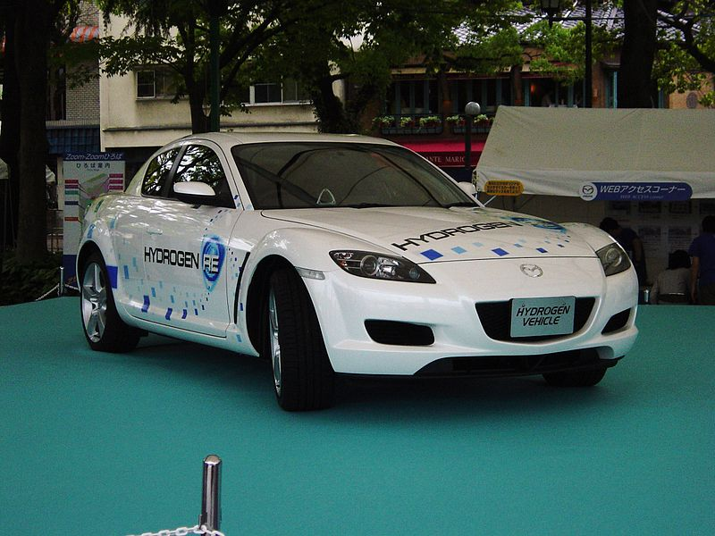



Future Fuel
This resource has been developed by the Association for Science Education for their RCUK-funded series
‘Research focused teaching resources to inspire students in STEM Careers’
Notes:
Photo: Taisyo, Wikimedia Commons
By User:Taisyo (ja:画像:RX8水素ロータリー車.jpg) [GFDL (http://www.gnu.org/copyleft/fdl.html), CC-BY-SA-3.0 (http://creativecommons.org/licenses/by-sa/3.0/) or CC BY-SA 2.1 jp (http://creativecommons.org/licenses/by-sa/2.1/jp/deed.en)], via Wikimedia Commons

Slide 2
How to use this resource…
Use this resource…
at the start of a topic to…
engage students in a real-life context relating to current research
to find out what students already know
consolidate existing understanding
at the end of a topic to…
assess student understanding by challenging students to apply their learning to a new context
to provide a contemporary example of how scientists are pushing the boundaries in understanding a subject area further
add depth and challenge
within a topic to…
enhance students’ confidence in the analysis of data by providing the opportunity to work with data types beyond those obtained in the school laboratory
assess student understanding of specific aspects of working with data (working scientifically by applying their understanding in a new context)
as an independent learning activity
to promote careers in STEM and show the varied work of scientists

Slide 3

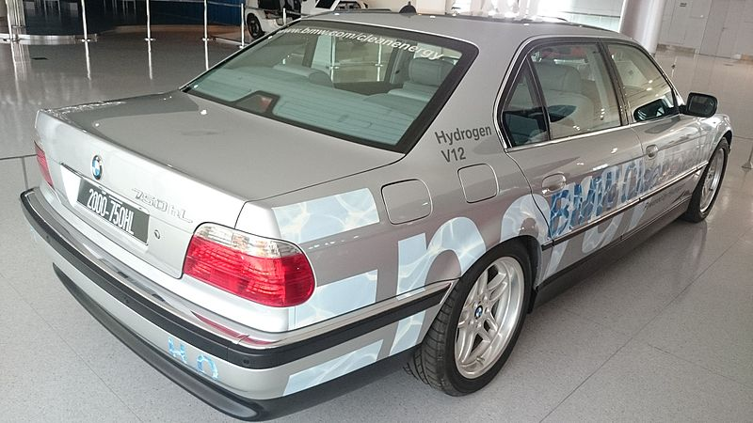
Research insight…
For a press release about the research, see press release.
Curriculum keywords
Chemical equations, chemical reactions, catalyst, fuel
Teacher answers to SS1 questions
Ammonia gas feeds into the reactor, in which hydrogen gas is produced. The hydrogen is purified, and then enters a fuel cell, which generates electricity.
A hydrogen leakage at a filling station, or damage to a car fuel tank, might lead to an explosion. The risk of this happening could be reduced by preventing the escape of the gas at filling stations, and by ensuring that fuel tanks are well sealed and strong enough to remain undamaged in collisions.
Any escape of ammonia, at a filling station or from a damaged fuel tank in a car, might cause health problems in humans. Risks could be reduced by preventing the escape of the gas at filling stations, and by ensuring that fuel tanks are strong and well sealed.
(a) 2NaNH₂(s) → Na(s) + N₂(g) + H₂(g) (b) 2Na(s) + 2NH₃(g) → 2NaNH₂(s) + H₂(g)
The sodium reacts with ammonia to produce sodium amide and hydrogen, as shown in reaction 2.
(a) The ammonia is used up, and it is not a product of either of the reactions. (b) Sodium amide decomposes in reaction 1, but is one of the products in reaction 2. This means that, as it is used up, it is also being made.
The nitrogen could be released to the atmosphere through the exhaust system of the car.
The BIG Research Question explanation
A hydrogen fuel cell may be used to provide electricity to run the motor of a car. Storing hydrogen in car fuel-tanks, and handling the gas at filling stations, is linked to the risk of explosions. Ammonia could be supplied regularly to the car at a filling station, and stored in a tank. A transport and storage system for ammonia already exists, and it is possible to make ammonia from sustainable resources – nitrogen from the air, and hydrogen from water. In a reaction vessel in the car, which contains sodium amide, reactions 1 and 2 could occur, producing nitrogen and hydrogen. The hydrogen is supplied to the fuel cell. The nitrogen escapes as a waste gas.
Notes:
Photo: By ChengH (Own work) [CC BY-SA 4.0 (http://creativecommons.org/licenses/by-sa/4.0)], via Wikimedia Commons

Slide 4
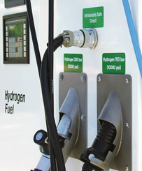

Researchers’ potential next steps
Dr Hazel Hunter, one of the team of scientists involved in the project, says that, ‘having developed this new approach to decompose ammonia, we are now creating a static demonstrator. Our technology will no doubt evolve, but our research invites scientists and technologists to address further questions, such as how we can make the system as safe and efficient as possible.’
Professor Bill David believes that, one day, ammonia may replace fossil fuels as a reliable, affordable and sustainable energy source.
Teacher guidance and answers to SS2a
Sodium amide can be said to be acting as a catalyst since it speeds up the reaction (a greater percentage of ammonia supplied is decomposed to its elements in a given time) and the same amount of sodium amide is present at the end of reaction as at the start.
Flow rate or temperature.
Flow rate or the substance used as the catalyst.
As temperature increases, so does the percentage of ammonia converted. The increase in the percentage converted is gradual at temperatures up to about 400 °C, then rapid up to 550 °C, at which point the conversion is 100%.
(a) The ruthenium-based catalyst performs best at 350 °C. (b) The sodium amide catalyst performs best at 500 °C.
Over the full range of temperatures, the performances of the two catalysts are similar. At lower temperatures the ruthenium catalyst performs slightly better and at higher temperatures the sodium amide catalyst performs slightly better.
The sodium amide catalyst is cheaper and more readily obtained.
Notes:
Photo: EERE, Wikimedia Commons [https://www.hydrogen.energy.gov/permitting/stations_storage.cfm]

Slide 5
Further activity suggestion 1: more on safety
Ask student groups to suggest further hazards linked to using ammonia and hydrogen to fuel cars. How could risks from these hazards be minimised?
Suggestions for minimising hazards include: ensuring that fuel tanks and filling station systems are well sealed; ensuring that fuel tanks are strong enough to withstand the forces in collisions; including sensors to detect escaped hydrogen and ammonia, which are linked to emergency cut off valves; including a back-up battery which would be used in the event of the utilisation of the cut off valves.
Further activity suggestion 2: designing an ammonia-fuelled car
Set student teams the challenge of designing an ammonia-fuelled car, in which hydrogen produced from the ammonia supplies a fuel cell. Ask teams to add annotations to show how the car works, including the chemical reactions involved. Where would be the best place in the car for each chemical reaction to occur?
Further activity suggestion 3: fossil fuel versus hydrogen car debate
Ask student groups to prepare arguments either for or against the motion By 2030, all cars should be fuelled by ammonia. Then hold a debate, in which student groups present their views and support them with evidence.
Notes:
Photo: Taisyo, Wikimedia Commons
By User:Taisyo (ja:画像:RX8水素ロータリー車.jpg) [GFDL (http://www.gnu.org/copyleft/fdl.html), CC-BY-SA-3.0 (http://creativecommons.org/licenses/by-sa/3.0/) or CC BY-SA 2.1 jp (http://creativecommons.org/licenses/by-sa/2.1/jp/deed.en)], via Wikimedia Commons

Slide 6
Useful links
Further information
Hydrogen breakthrough could be a game-changer for the future of car fuels
This article outlines the research and speculates about its possible implications.
Ammonia – a forgotten fuel?
This article addresses the question: Can ammonia be the long-term, carbon-free alternative to fossil fuels?
SFTC project announcement – summaries of four projects – including that described in this activity – which aim to solve energy challenges.
Bill David – this web page tells of a recent award to the lead scientist in the research project.
Other resources from Science and Technology Facilities Council
STFC Explore our science
This page is a window into STFC’s science and technology, and how large facilities – from giant telescopes, to laser facilities, supercomputers and the Large Hadron Collider – help physicists, chemists and biologists to understand our world and the Universe beyond.

Slide 7
Acknowledgements
Research paper
This resource is based on the research paper:
^{1,2} David WIF, ^{1,2} Makepeace JW, ¹ Callear SK, ¹ Hunter HMA, ¹ Taylor JD, ¹ Wood TJ, ¹ Jones MO. (2014) Hydrogen production from ammonia using sodium amide J. Am. Chem. Soc. 136: 13082 - 13085.
¹ ISIS Facility, Rutherford Appleton Laboratory
² Inorganic Chemistry Laboratory, University of Oxford
Thank you to Bill David for permission to use the diagrams, photographs and graph on slides 5, 6, 7 and 8 of the Student PowerPoint.
Organisations
The research was funded by Science and Technology Facilities Council (STFC)
Bill David is STFC Senior Fellow at the ISIS Facility, Rutherford Appleton Laboratory, Oxfordshire, UK, and Professor of Chemistry in the Inorganic Chemistry Laboratory, University of Oxford, and Fellow in Physics at St Catherine’s College, Oxford.

