Slide 1
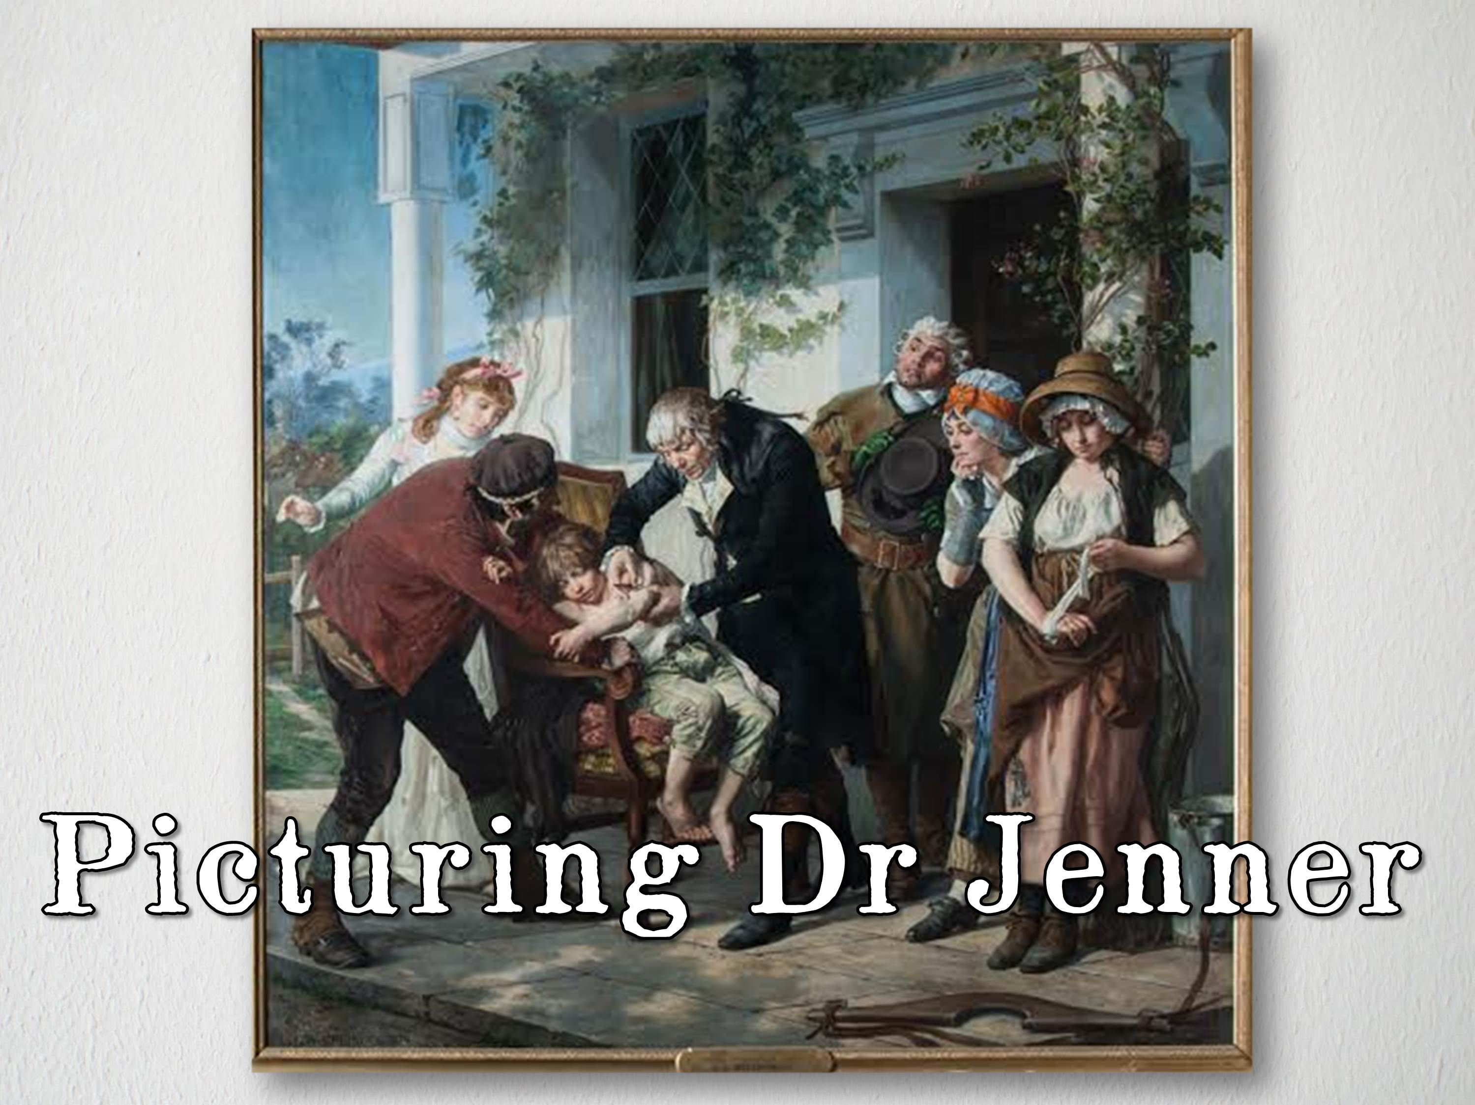


Slide 2
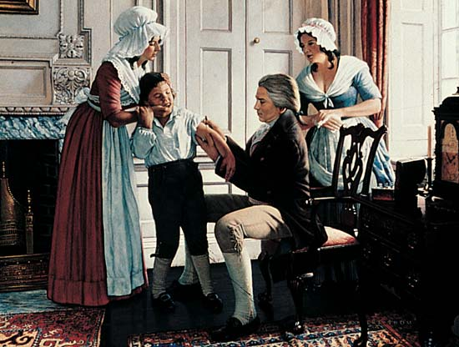
Notes:
Jenner: Smallpox is Stemmed by Robert A. Thom

Slide 3
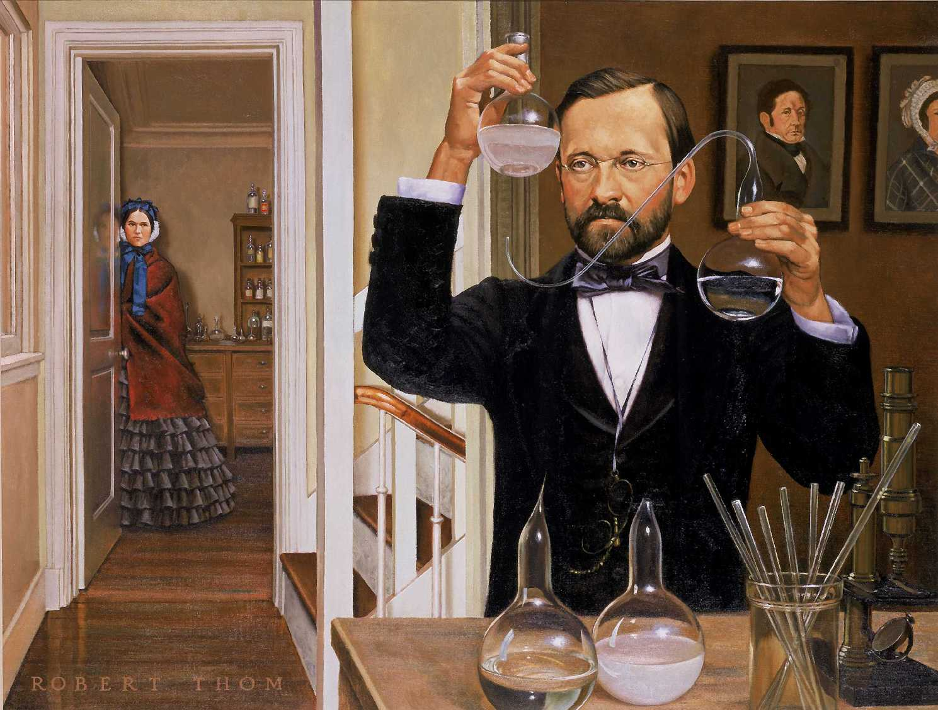
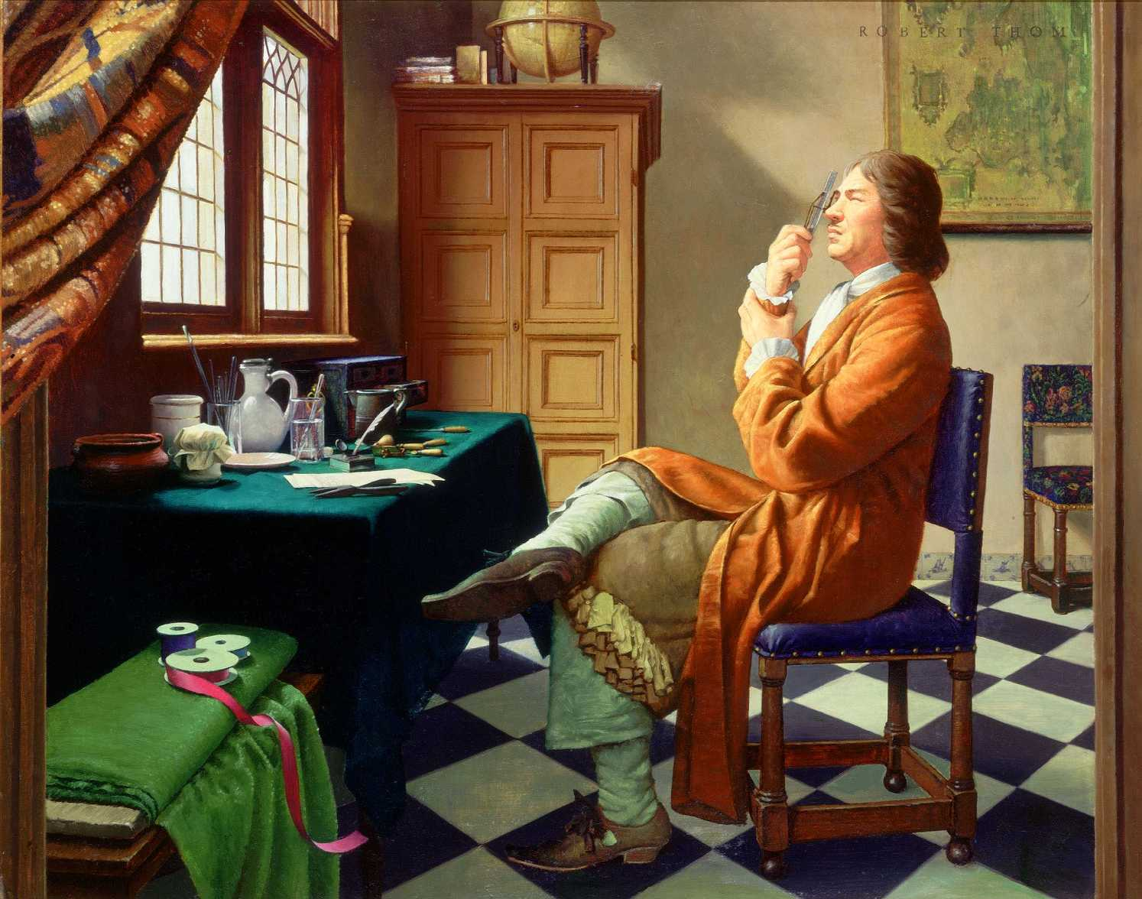
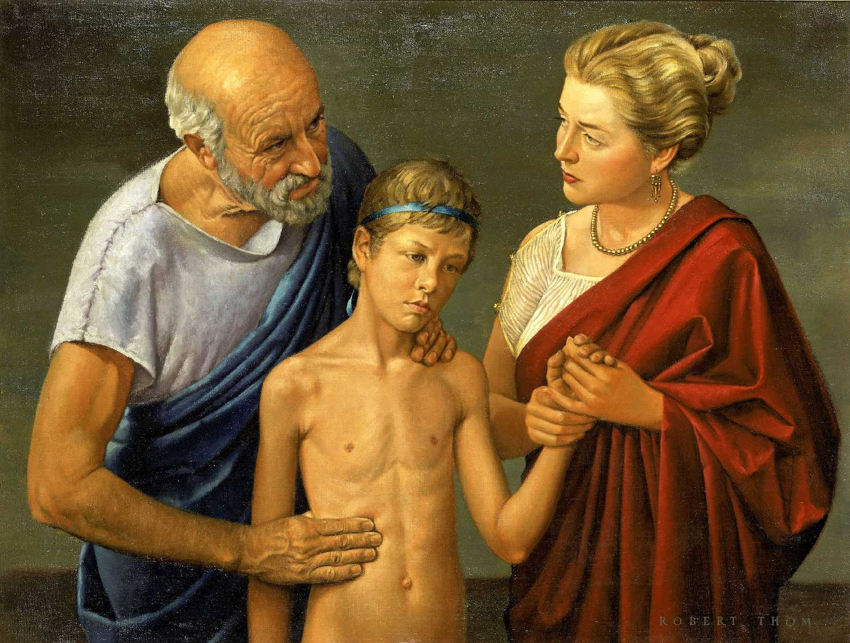
You can’t fake history.
You have to know how people lived, what they wore,
their physical surroundings, the architecture and furniture of the time, the tools of the physicians.
My responsibility is to make you forget they’re paintings and feel that you’re actually there.
Robert A. Thom

Slide 4
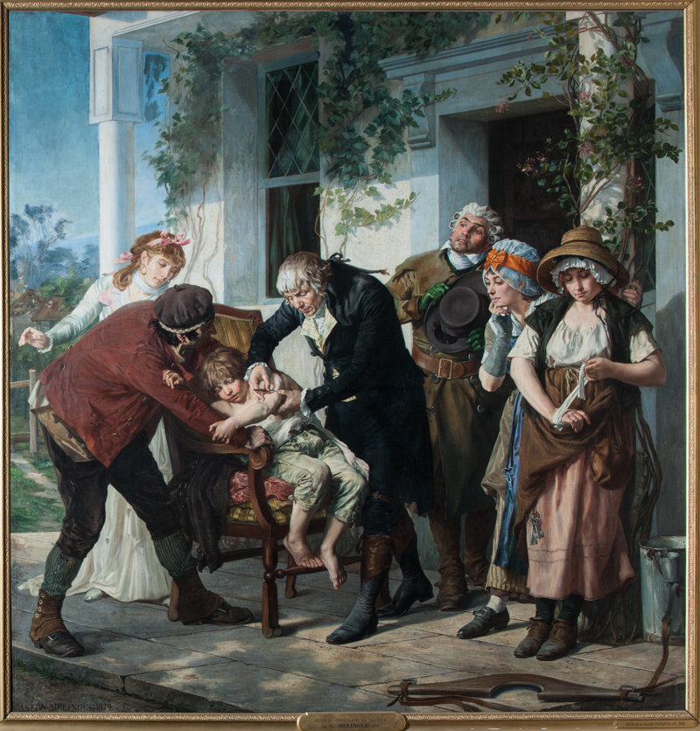
Notes:
Dr Jenner performing the first vaccination against smallpox in 1796
by Gaston-Theodore Melingue, 1879

Slide 5
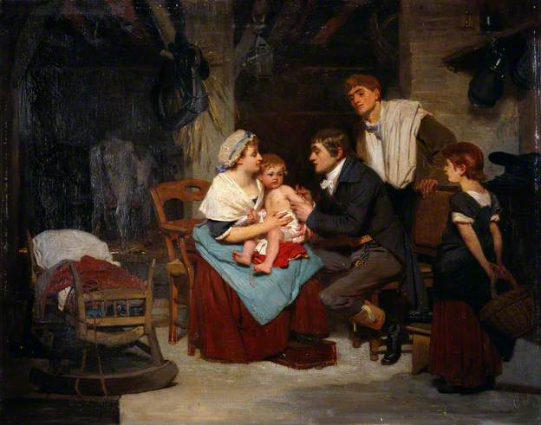
Notes:
Edward Jenner Vaccinating a Boy by Eugène-Ernest Hillemacher, 1884

Slide 6
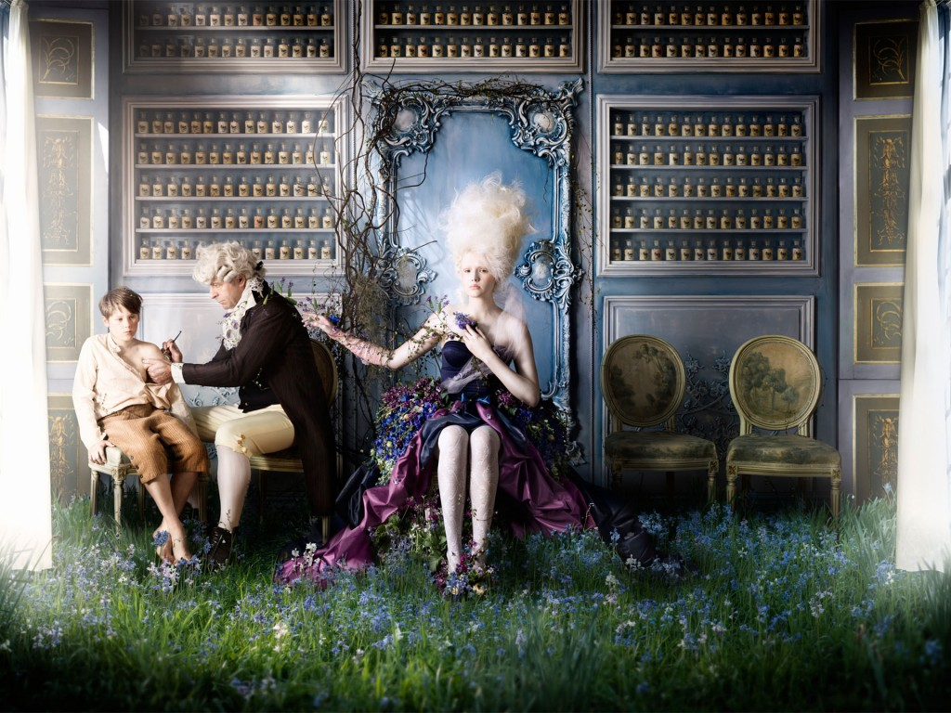
Notes:
Edward Jenner’s Smallpox Discovery, by Alexia Sinclair, 2015

Slide 7
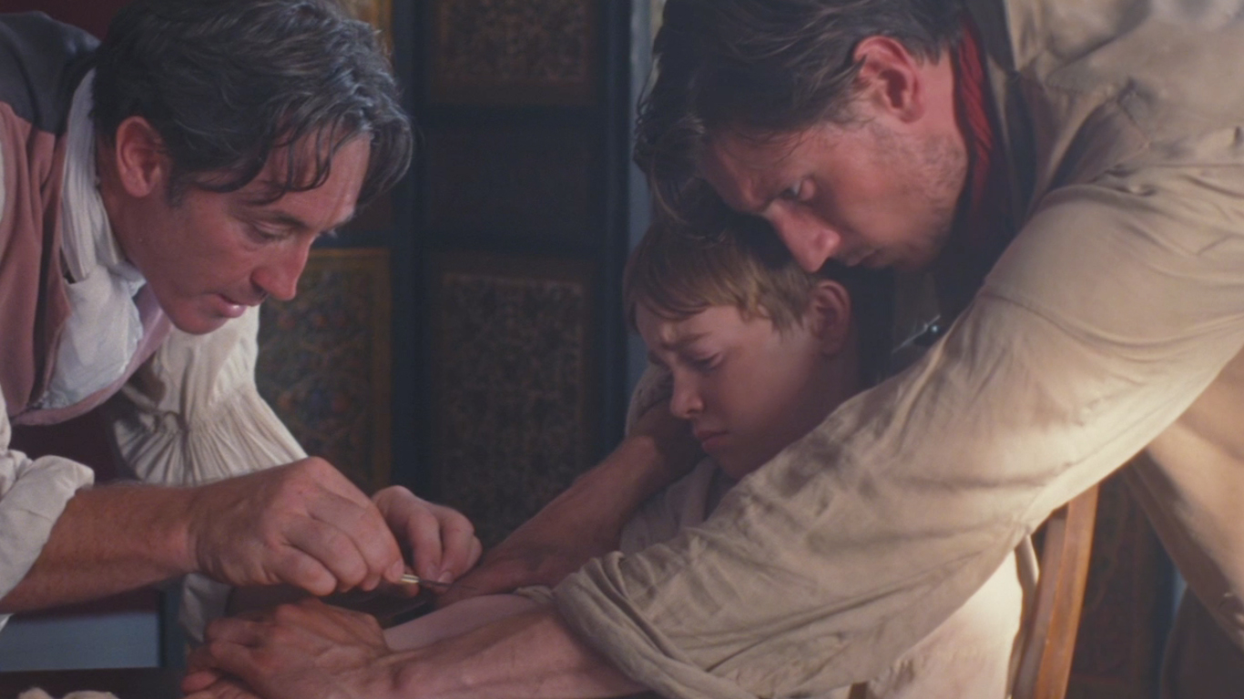
Notes:
A still from the JAMES short film, made in 2014

Slide 8

1884
1879
1950
2014
2015

Slide 9
1884 1879 1950 2014 2015

Slide 10


© ASE and James Films
This activity was produced by the
Association for Science Education
in partnership with
James Films

