Slide 1


Slide 2
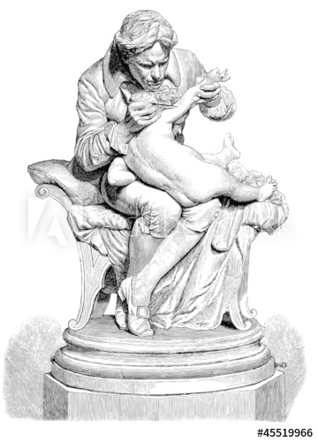
What was smallpox?
What is a vaccine?
Who was the last ever person to die of smallpox?
Why will you never catch smallpox?

Slide 3
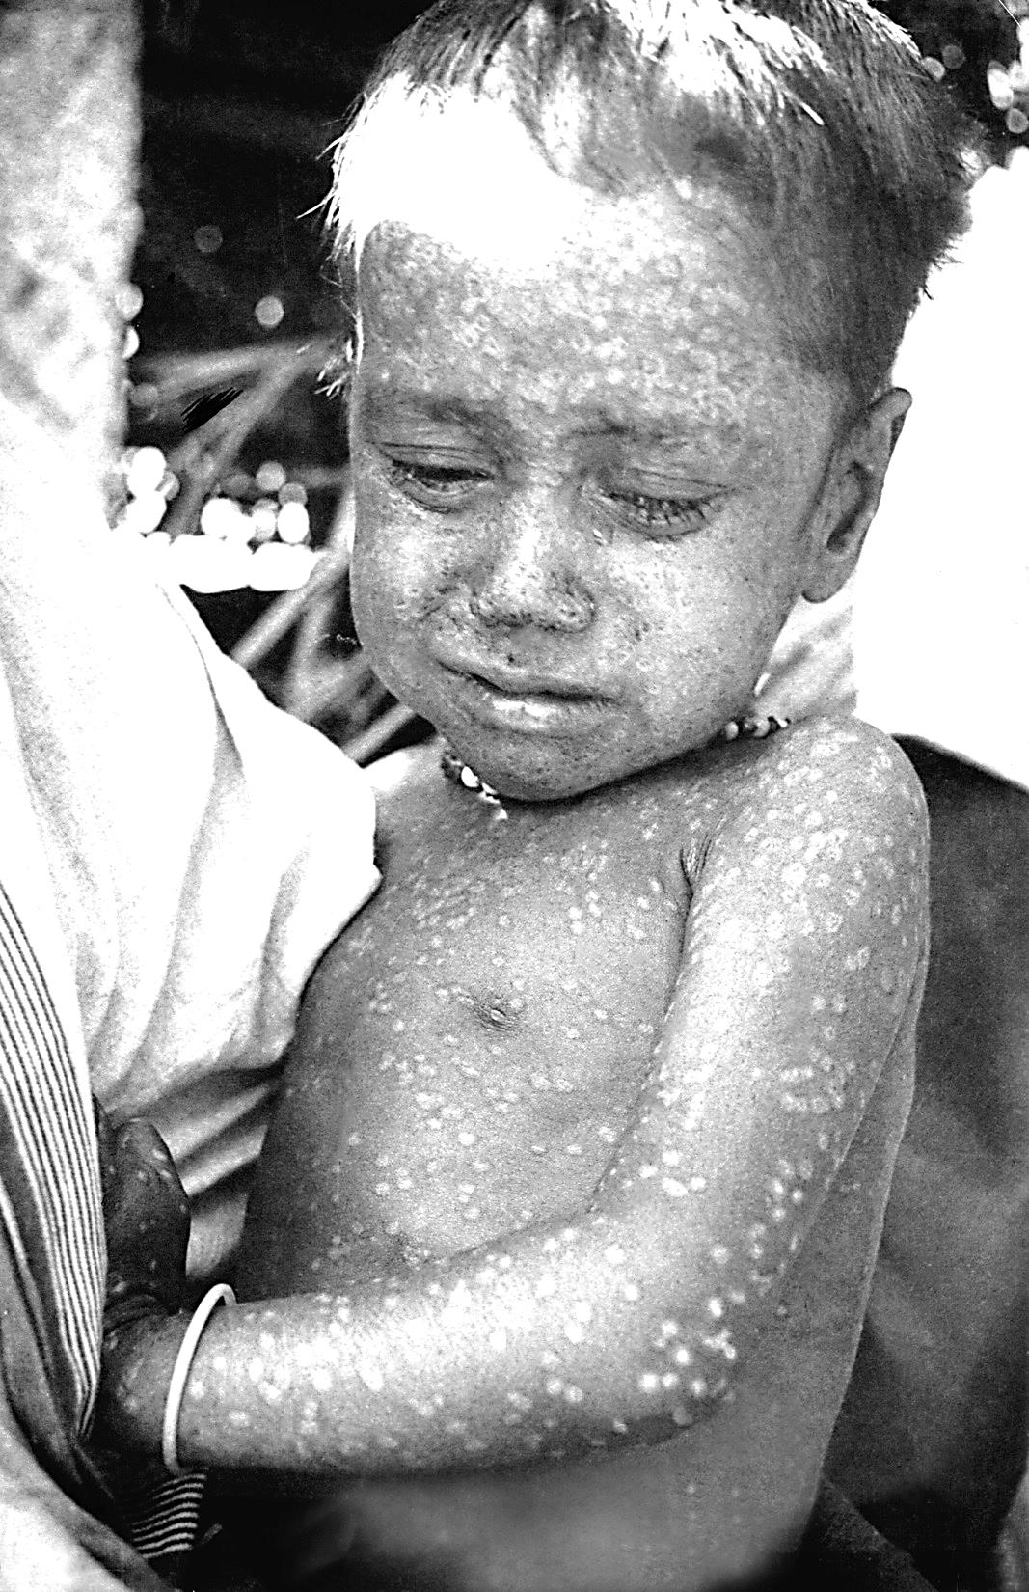
Two-year-old Rahima was infected with smallpox in Bangladesh in 1975.
Thankfully, she made a full recovery.
But many people in her village treated her badly later in life because she had had the disease.
Notes:
https://en.wikipedia.org/wiki/Rahima_Banu#/media/File:Rahima_Banu.jpg

Slide 4
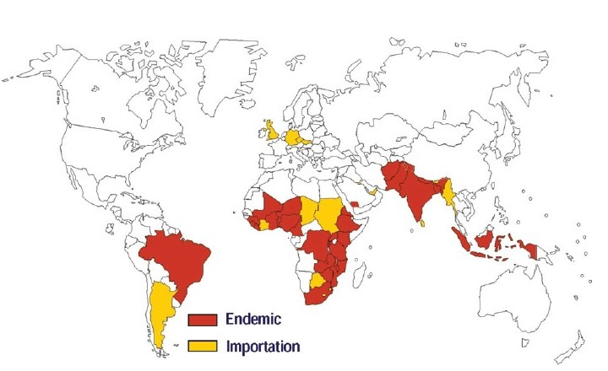
These are the countries where there were smallpox cases in 1967.
The countries in yellow mean that the people there caught smallpox in one of the countries in red.
Notes:
http://www.ijph.in/article.asp?issn=0019-557X;year=2011;volume=55;issue=2;spage=81;epage=87;aulast=Narain

Slide 5
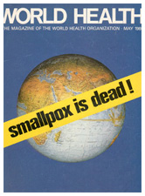
In 1980, the World Health Organisation (WHO) declared that the smallpox disease had been eradicated.
This means that it had been completely wiped out.
The world was free from the horrors of smallpox forever!
How do you think people managed to eradicate smallpox?

Slide 6
vaccination
notification
isolation
Notes:
https://apps.nlm.nih.gov/againsttheodds/exhibit/preventing_disease/making_history.cfm

Slide 7

vaccination
isolation
notification
Notes:
https://apps.nlm.nih.gov/againsttheodds/exhibit/preventing_disease/making_history.cfm

Slide 8
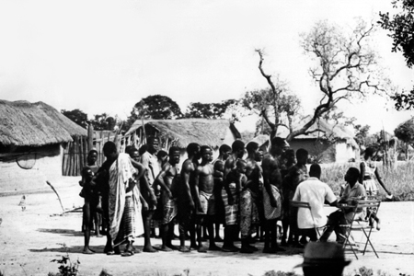
vaccination
notification
isolation
Notes:
https://apps.nlm.nih.gov/againsttheodds/exhibit/preventing_disease/making_history.cfm

Slide 9
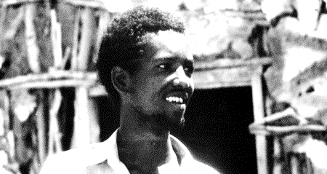
notification
vaccination
isolation

Slide 10
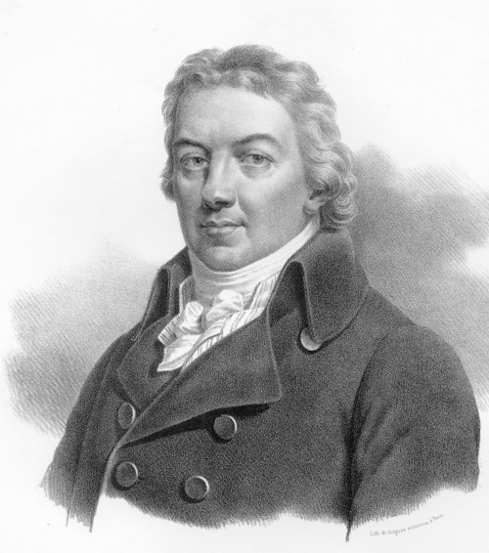
I hope that some day the practice of producing cowpox in human beings will spread over the world – when that day comes, there will be no more smallpox.
Thank you,
Dr Jenner!
Who do you think said this?
Notes:
image
https://en.wikipedia.org/wiki/Edward_Jenner#/media/File:Edward_Jenner._Pastel_by_John_Raphael_Smith._Wellcome_L0026138.jpg

Slide 11
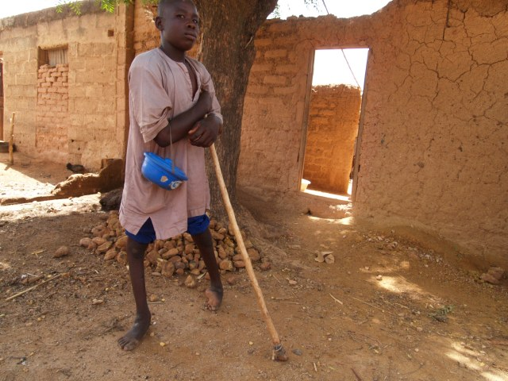
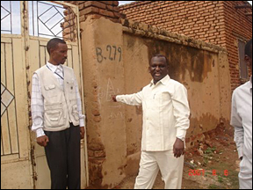
Polio
Notes:
http://www.polioeradication.org/MediaRoom/Photos/Photoessays.aspx#prettyPhoto[Sudan]/3/
http://www.polioeradication.org/Mediaroom/Photos/Photoessays.aspx#prettyPhoto[LastStand]/2/

Slide 12
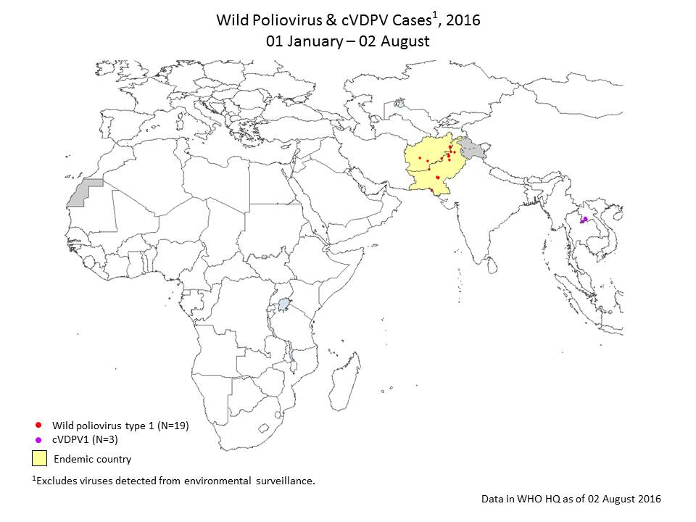
Notes:
You can find the most recent version of this graph here:
http://www.polioeradication.org/Dataandmonitoring.aspx
The site contains the most up to date information about efforts to eradicate polio

Slide 13
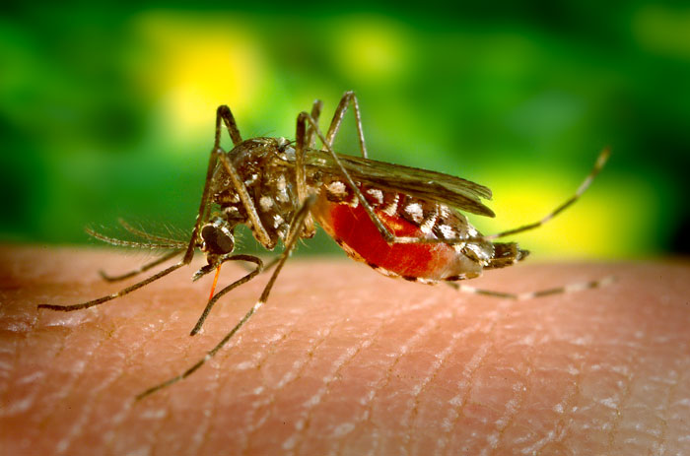
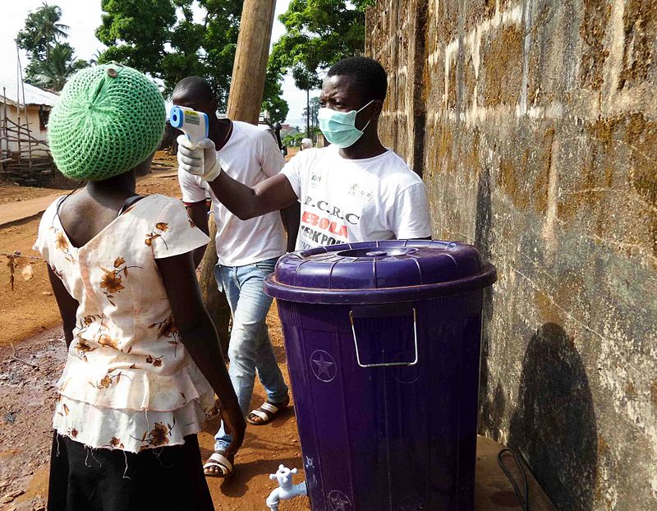
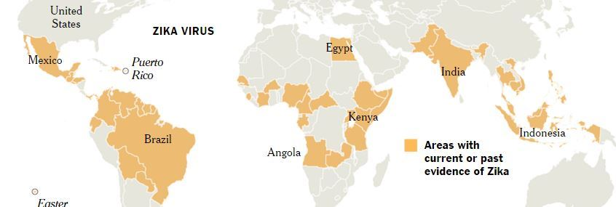
Yellow Fever
Ebola
Zika
Notes:
Images
https://en.wikipedia.org/wiki/Ebola_virus_disease#/media/File:Measuring_Temperature_at_a_road_block_in_Lakka_Sierra_Leone.jpg

Slide 14
What vaccinations have you had?
What other diseases could we eradicate with vaccinations?
How many more lives could be saved by vaccinations?
Do vaccinations exist for every disease?
Why do people across the world still die of diseases that we already have vaccines for?
If we have a vaccine for a disease, why hasn’t it been eradicated?

Slide 15

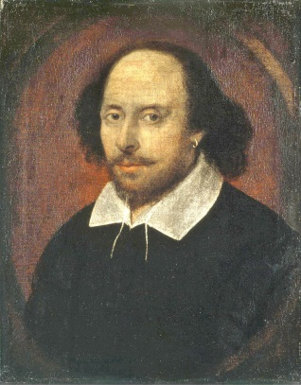
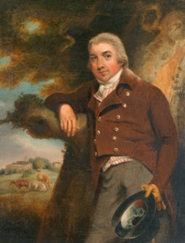

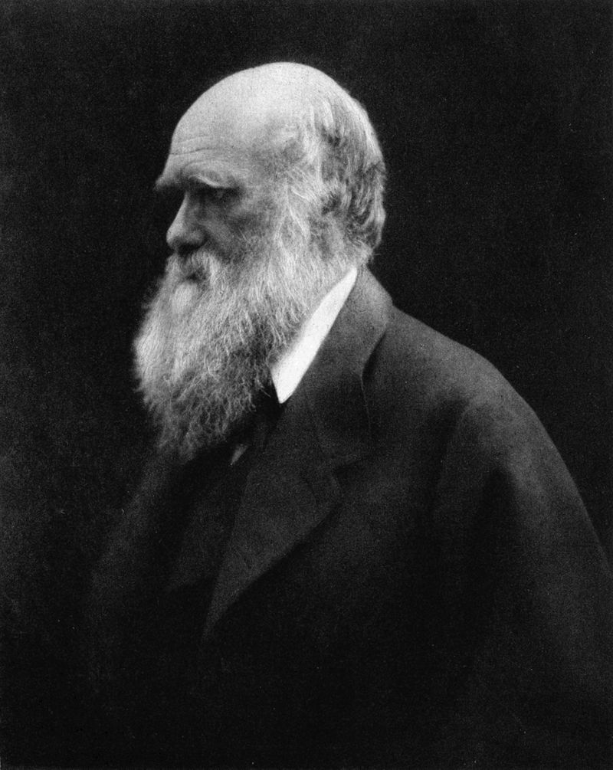
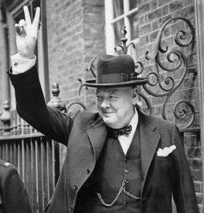
Notes:
Images
Wikipedia

Slide 16

Historian Andrew Marr asks…
“Who is the Briton the
world should most
revere?”
“There is an obvious case for William Shakespeare, another very powerful one for Charles Darwin (my particular hero) and a different argument for Winston Churchill. But we need to put Edward Jenner, the Gloucestershire doctor
who discovered vaccination, right up there as prime
candidate.
Smallpox had been one of the great scourges of
the human race, a disfigurer and a huge killer,
particularly of children. Jenner's
breakthrough meant it was eventually
eradicated – and the United Nations
declared it had gone in 1980.
Notes:
www.bbc.co.uk/news/magazine-19912733

Slide 17
We can plausibly claim that Jenner saved more human lives than any other person in history, and that on this basis he is surely a candidate for greatest Briton. And it all happened in the sleepy, green, rolling backwaters of Gloucestershire, still a great place
for a stroll.”
Can you identify the facts and the opinions?
What do you think?

Slide 18



© ASE and James Films
This activity was produced by the
Association for Science Education
in partnership with
James Films

